Slide 1
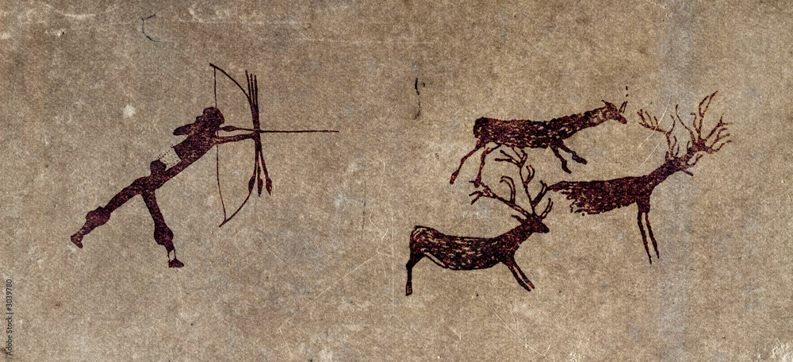
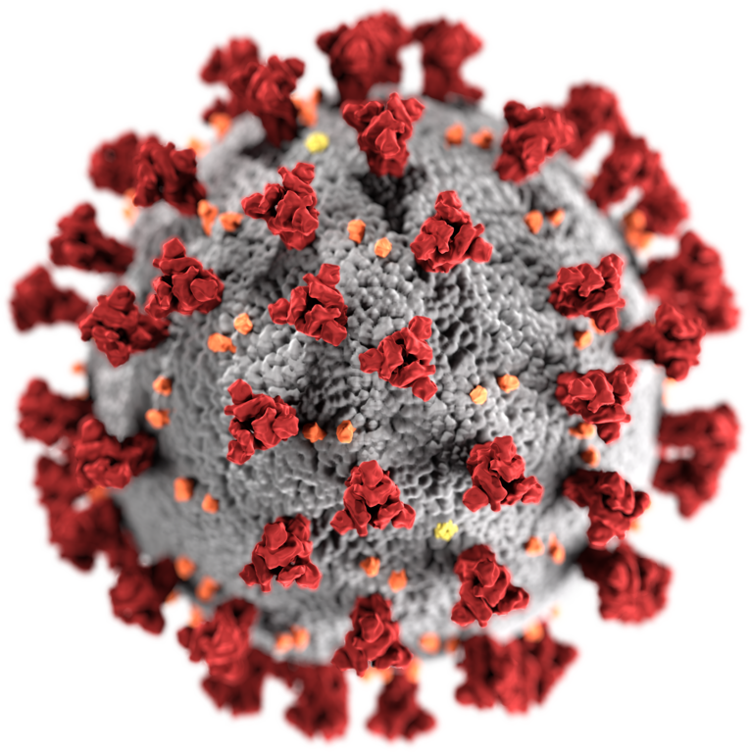
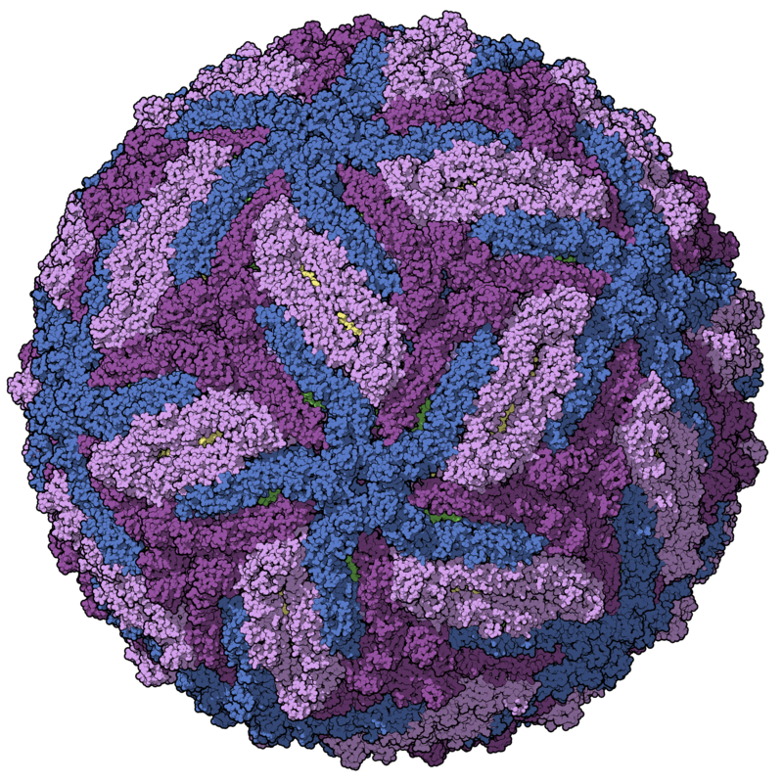
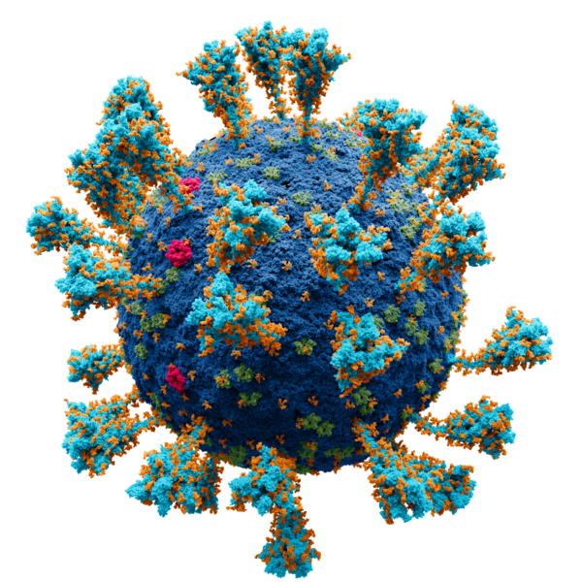
Virome characterisation from unprocessed local and publicly available sequencing data
VirushunterGatherer and Virusparies
Sergej Ruff
Twincore - RG Computational Virology
22 August 2024
Notes:
→ Good Morning
→ Today, Presenting the current progress of my master thesis, which I started almost 2 months ago.
→ Topic is the characterization of the virome after liver transplantation
→The Taubert Working Group at the MHH were so kind to provide me with liver Sequencing data
→ and I am applying VirushunterGatherer to characterize the virome of those samples and maybe find novel viruses.
→ Then I am plotting and analysing the output using a small R package I created called Virusparies.

Slide 2
Characterzation of the virome,VirusHunterGatherer and Virusparies - Outline
Methods and Material used
Reminder: VirusHunterGatherer and Hittables
Taubert Data
Mammal Data
Results
SRA Data
Taubert
Virusparies Package
3. Concluson and Outlook
Notes:
The outline of the presentation
Follows the classic Paper/ Journal Structure.
First → Talk about the motivation behind virus discovery.
Second → Then I want to talk about the history of viral discovery real quick and how it applyes to vhvg.
Method → Talk about the data and changes made to VhVg. Present the output of VhVg that I used for further analysis.
Results
Conclusion and Outlook.

Slide 3
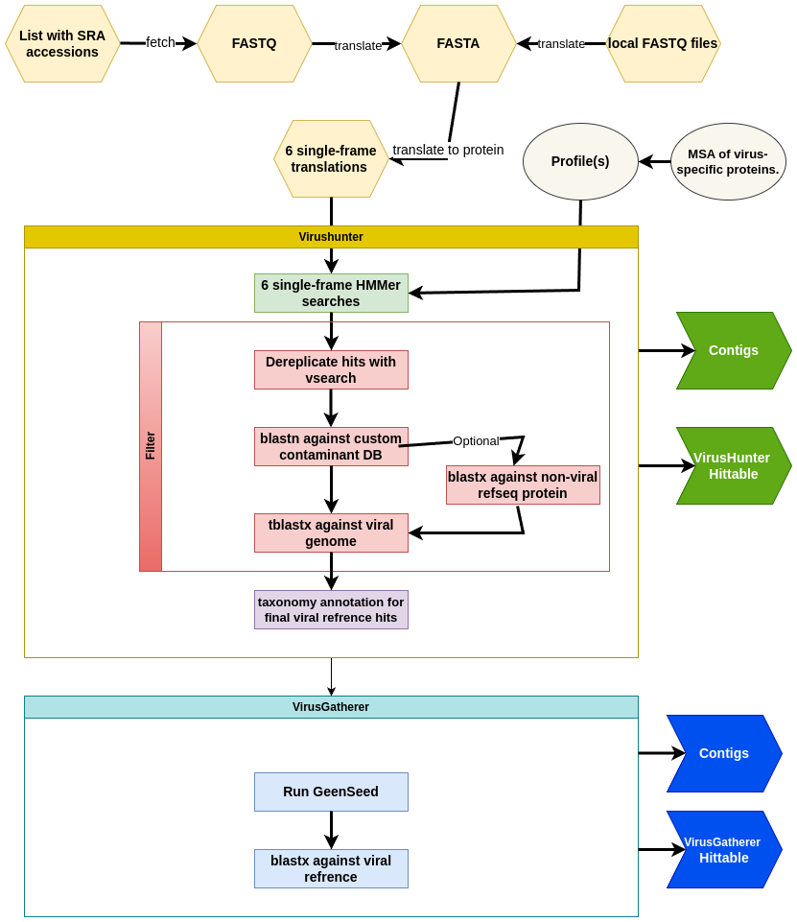

Reminder: VirusHunterGatherer
Local Taubert and Pfaff Data
Mammal SRA IDs
Hittables
Hittables
Virusparies
Virusparies
Notes:
Reminder: Use VhVg
> Perform Data driven viral discovery by running our unprocessed data against profiles in an Hidden Markov model
> Filter against contaminants and viral data base
> Use found contigs as seeds for progressive assembly of viral contigs in gatherer
>perform taxonomic annotation with blast
> generate hittable for 3 data sets. Only 2 used for master thesis

Slide 4
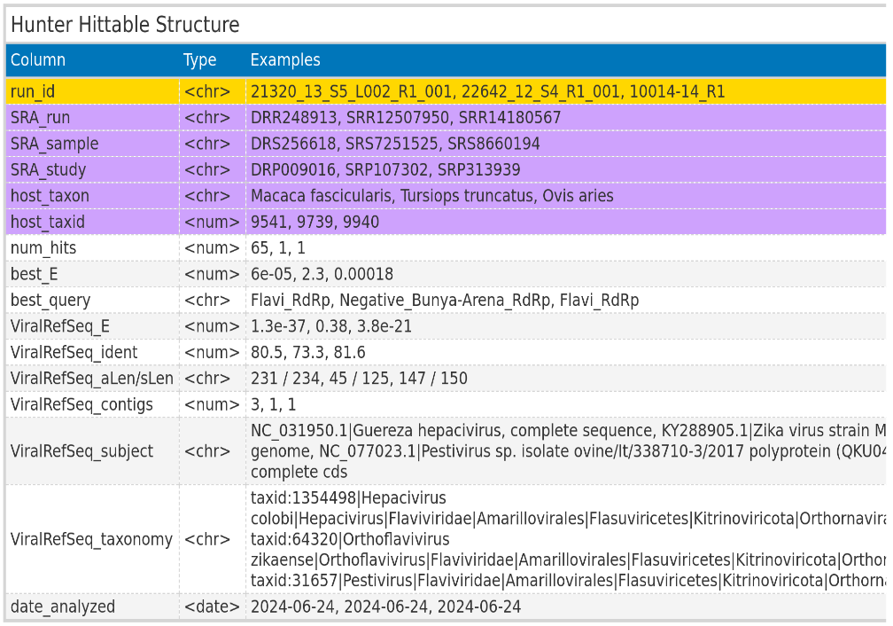
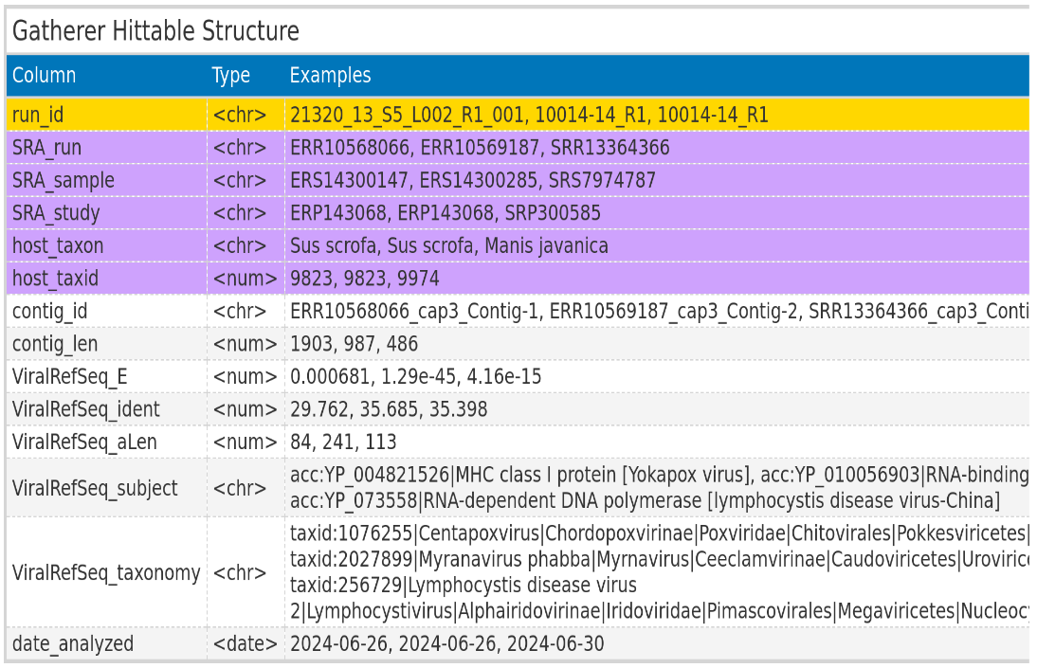
Reminder: Hittables
ViralRefSeq_taxonomy processed to extract virus family
Notes:
The VhVg output I use for downstream analysis: Hittables
> Save the best results for the search against profiles and the search against the viral database.
> Some columns are exclusive to local files, some are for fetched files.
> Processed taxonomy
> Next I want to describe the data is used.

Slide 5
Taubert Data
Local files from AG Taubert
Samples: Liver
All 3 Virus groups
Notes:
> Start with taubert
> Taubert working group at mhh
> Focus on immune response of liver before and after transplantation.
> Kind enough to provide patient liver data
> I searched all 3 viral groups

Slide 6
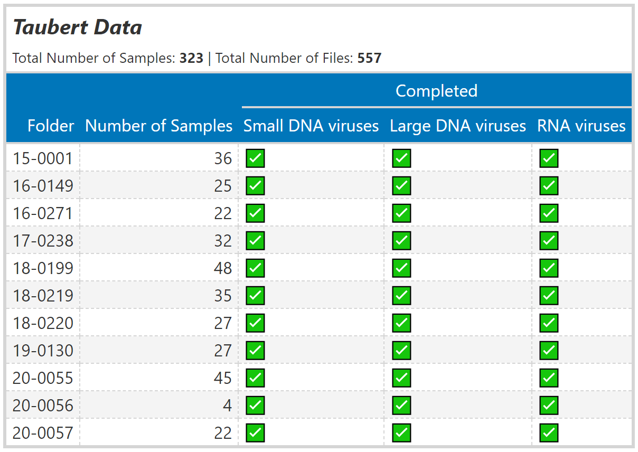
Material used: Taubert Data
Notes:
> Folder structure
> Paired end reads seperated into files → more files than samples. 323 samples but 557 files

Slide 7
Mammal Data
SRA IDs re-examined from existing Hittable
RNA viruses only
Notes:
Next → Chris provided me with existing hittable.
→ Consisting of Mammalian data
> I subset the hittable for specific criteria and analyzed the subset again.
> The hittable contained RNA viruses for mammals. Therefore I only ran the RNA virus group for VHVG.

Slide 8
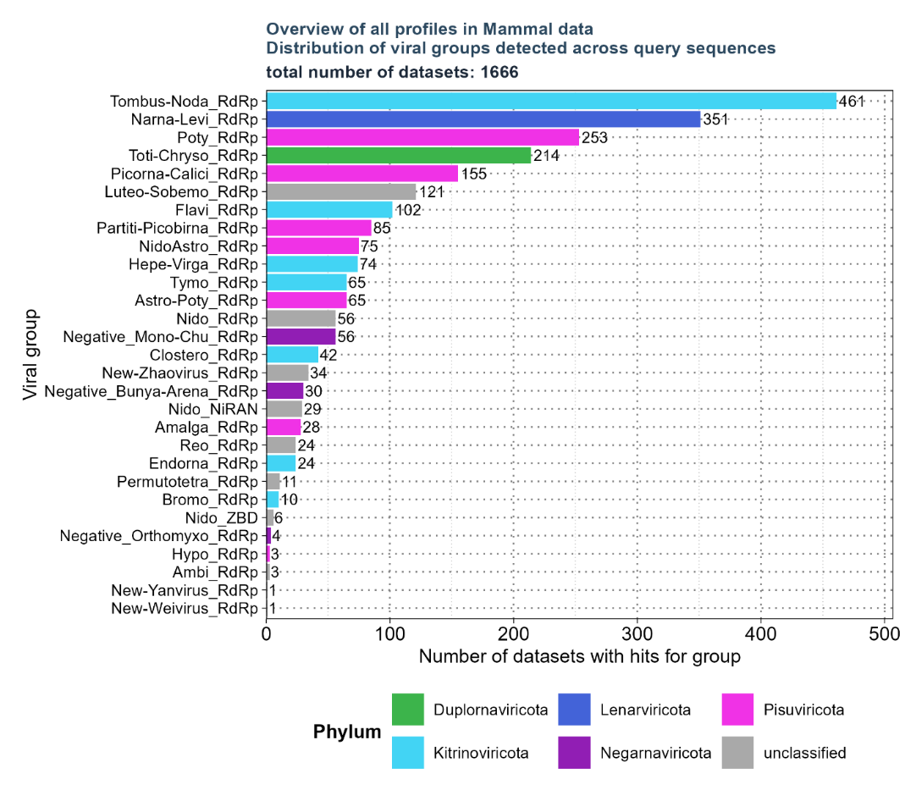
Material used: Mammal Data – overview of existing hittable.
Selected profiles:
Flavi_RdRp
Hepe-Virga_RdRp
Nido_RdRp
Negative_Bunya-Arena_RdRp
Negative_Mono-Chu_RdRp
Negative_Orthomyxo_RdRp
Nido_NiRAN
NidoAstro_RdRp
Existing Hittable:
34.337 unique SRA Ids
Filtered based on:
'num_hits' > 4
'ViralRefSeq_E' < 1e-5
'ViralRefSeq_ident' < 90
Notes:
> Almost 100000 observatiosn with 34.000 samples.
> Criteria filtered : contig length criteria to make sure, something gets assembled by gatherer, only significant groups and we concentrate on novel viruses.
→ 1666 SRA ids left
> Still too much. Further filtering for specific groups
> Analyzed 6/8 groups

Slide 9
Florian Pfaff Data
Local files from Institute of Diagnostic Virology (Friedrich-Loeffler-Institut)
Samples: Wild boars
All 3 Virus groups
Notes:
> Not part of the final master thesis, but I also analyzed the data for Dr. Florian Pfaff from …
> Wild hogs samples
> all 3 groups
> I will not go in detail since it wont be part of my thesis.

Slide 10
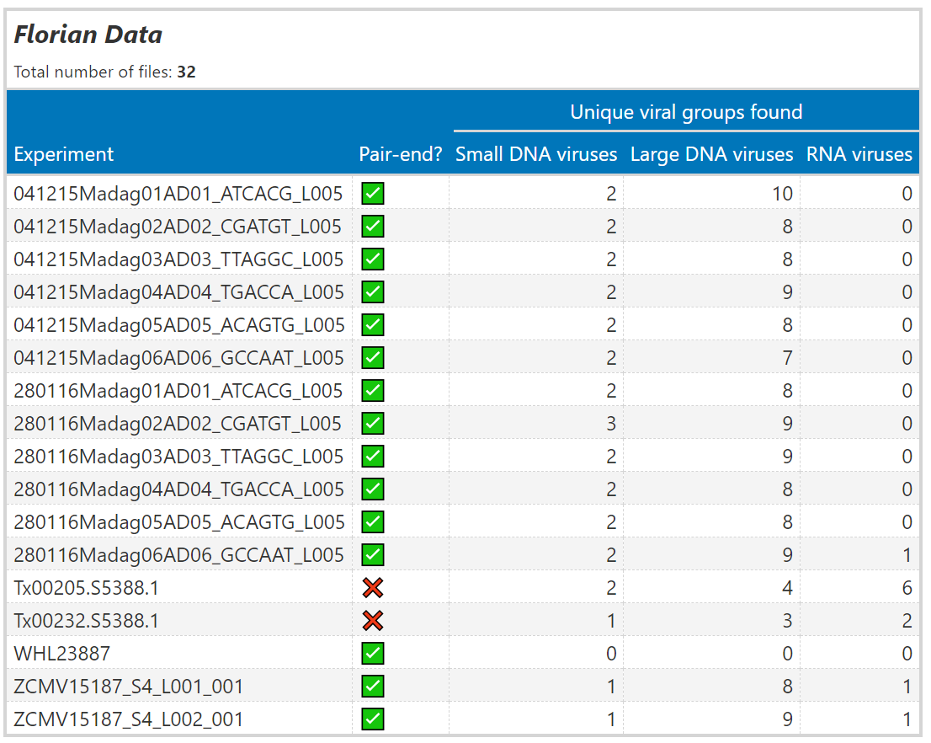
Material used: Florian Pfaff Data
Notes:
> 17 Samples
> 32 files
> Shows how many viral families each file found
> 1 found nothing. The rest found at least 1 for DNA viruses, and 5 found RNA.

Slide 11
Results: Taubert
Notes:
Lets talk results. Starting with taubert

Slide 12
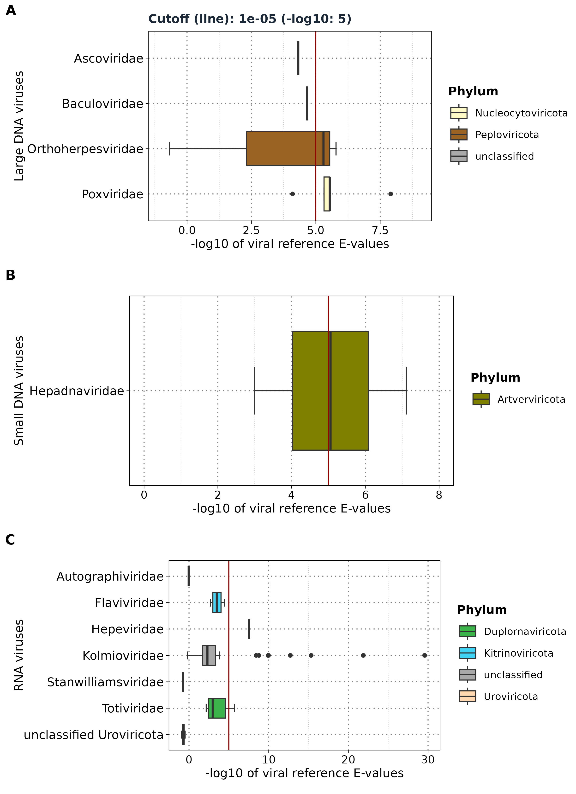
Results: Taubert - E-values
Showing only Gatherer results
Viral reference E-values for each group
Notes:
> Here you see the E-value distribution for all 3 families.
> The red line shows a cut of 10 to the power of -5.
> We use the log10 of evalues
> Sort by median.
> Everything below that is not significant and wont be shown on the next plots.
> 1. You can see not a lot was found for 557 files
> 2. All the observations are close to the cutoffline.
> 3. See uroviricota which are usually dsDNA phages among RNA viruses.

Slide 13
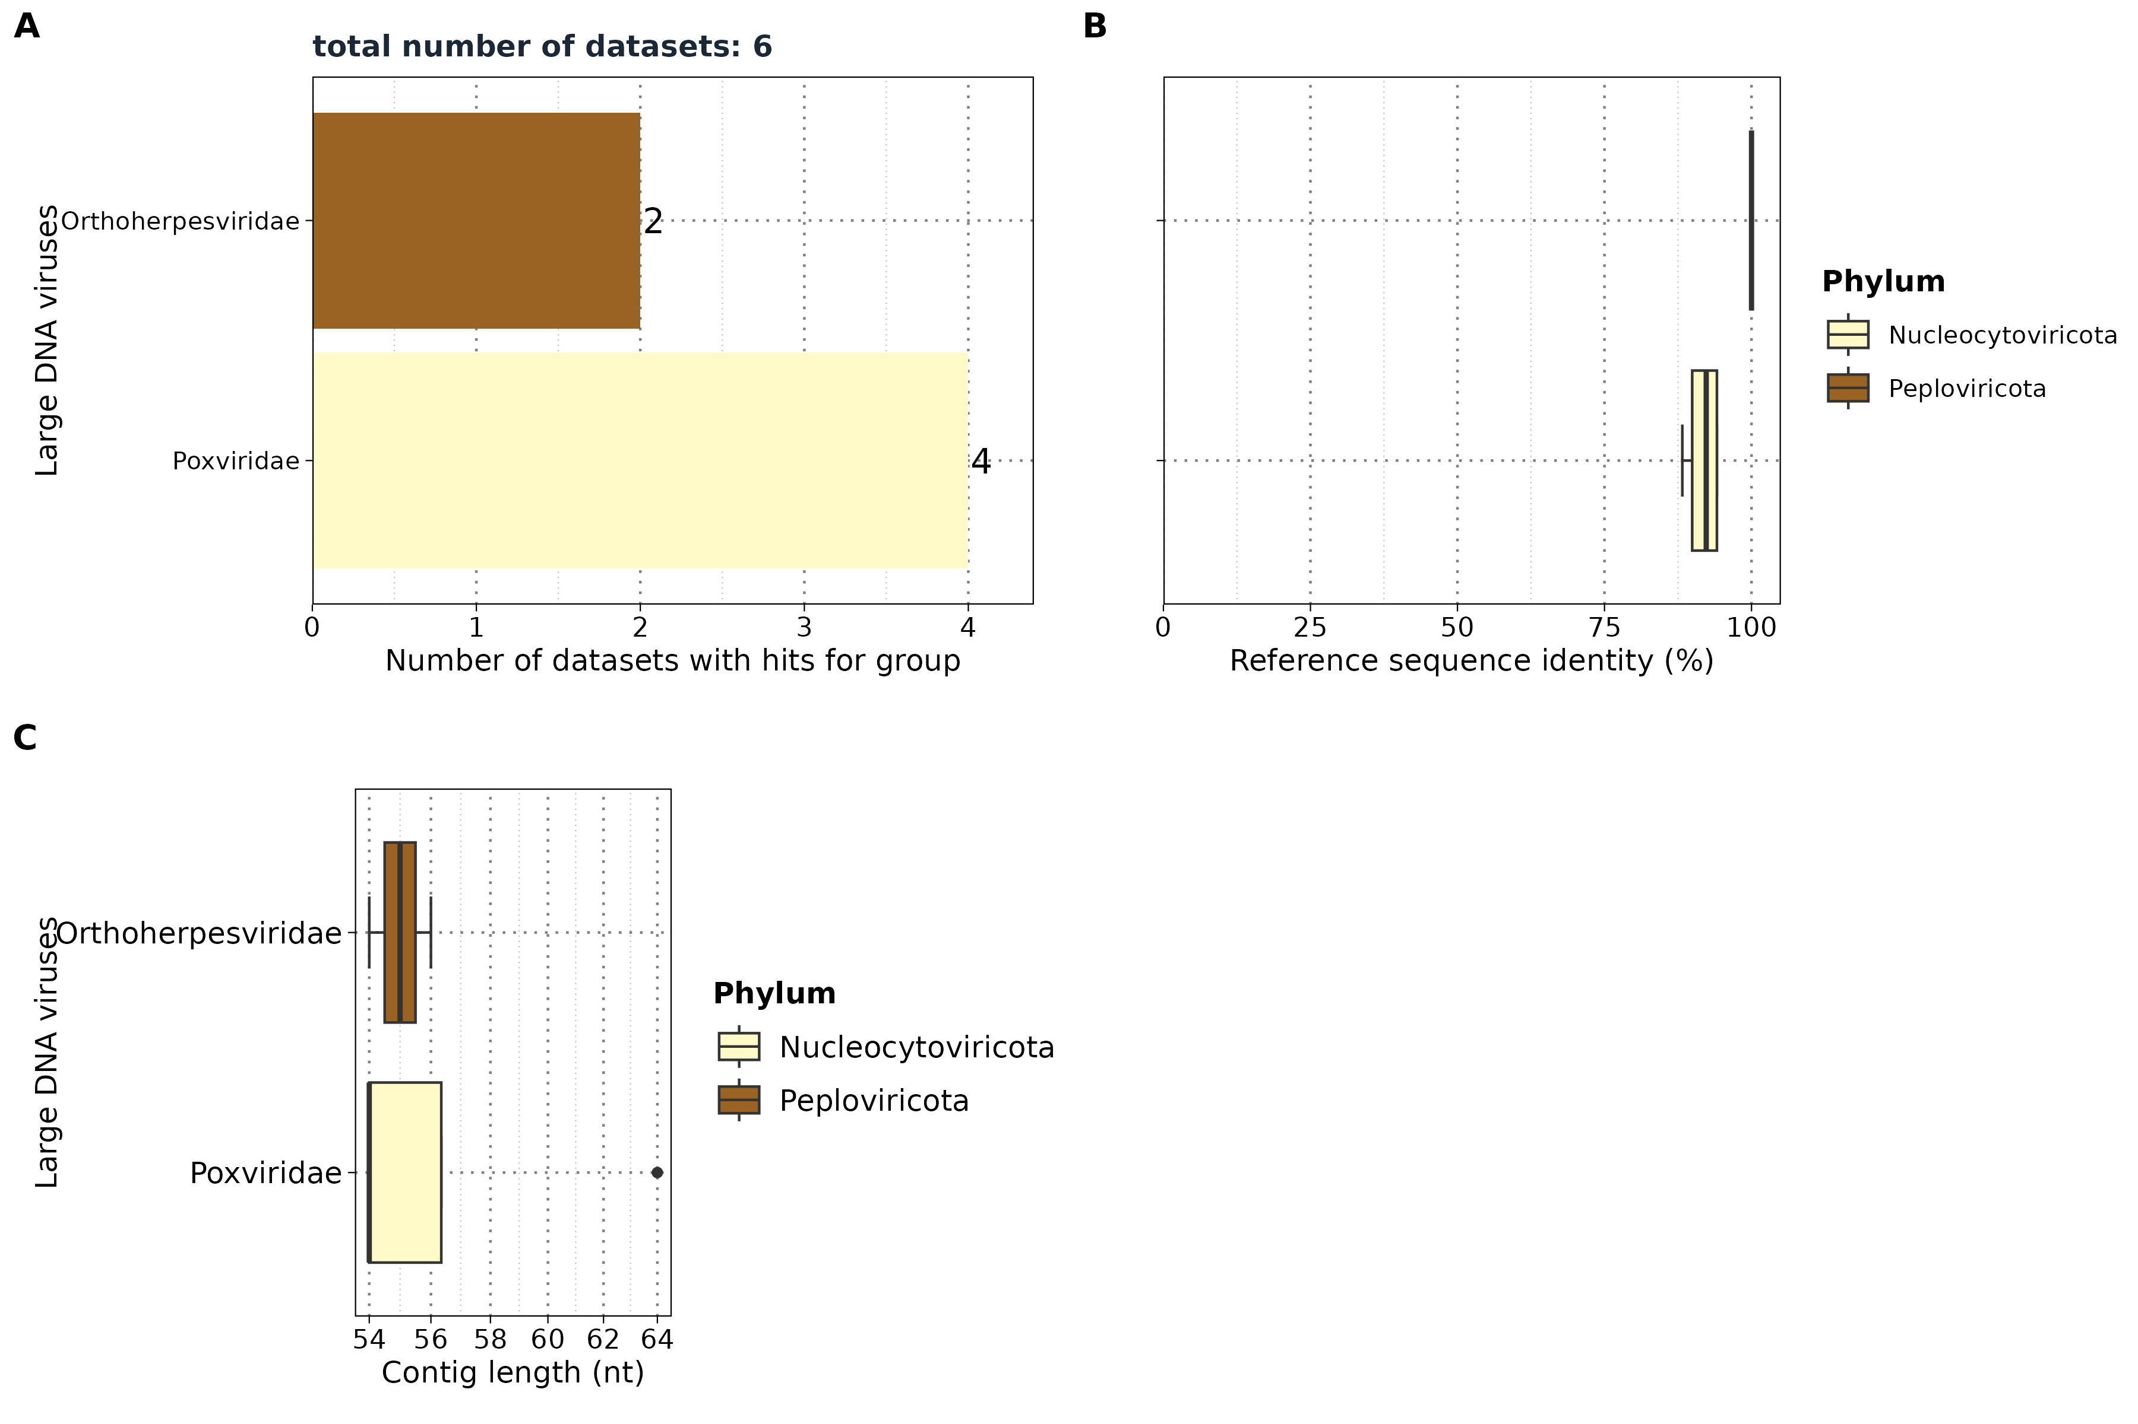
Results: Taubert
Large DNA viruses
Notes:
Viral Group entferen in dem B plot bei allen Datensätzen

Slide 14
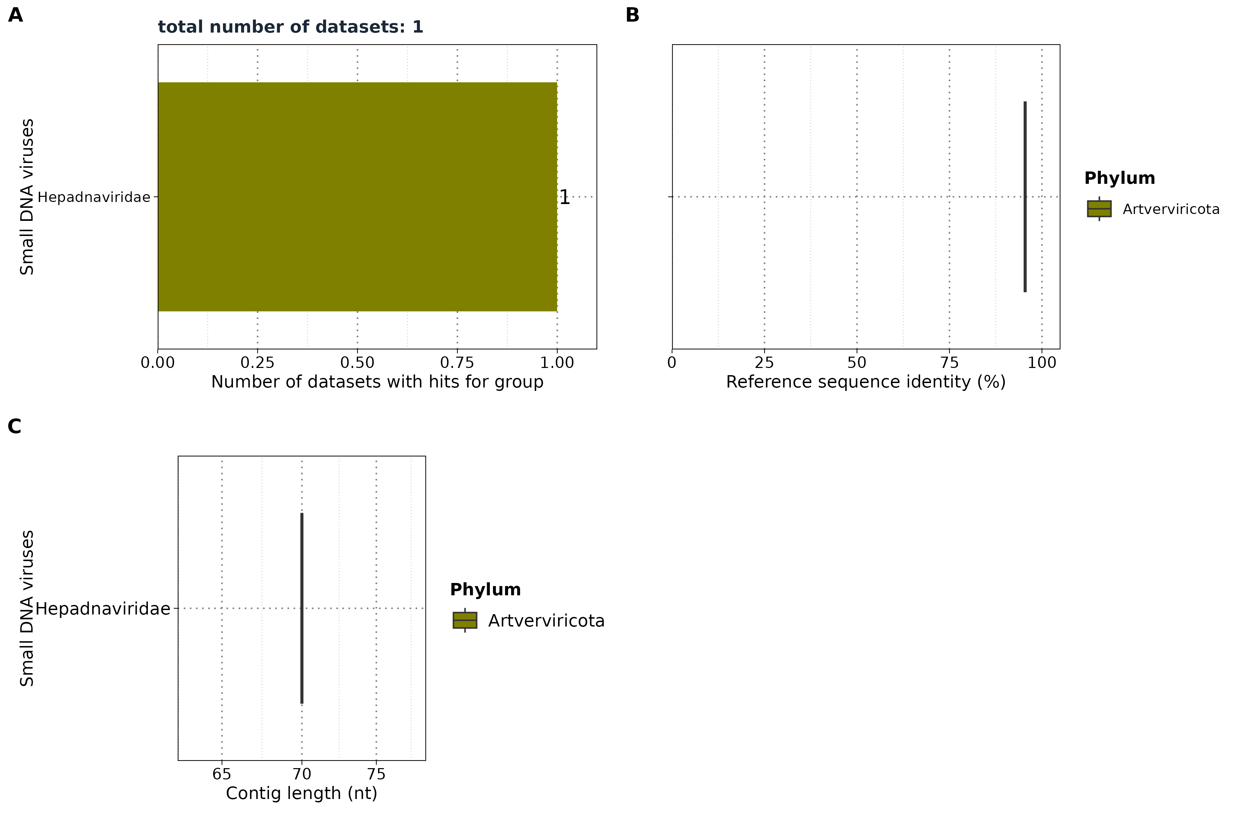
Results: Taubert
Small DNA viruses
Notes:
From here on out all plots which dont plot the e-value will be filtered for 10⁻5. Thats why you see fewer results. The same applyes for teh other data sets.
Only signficant groups are shown here.

Slide 15
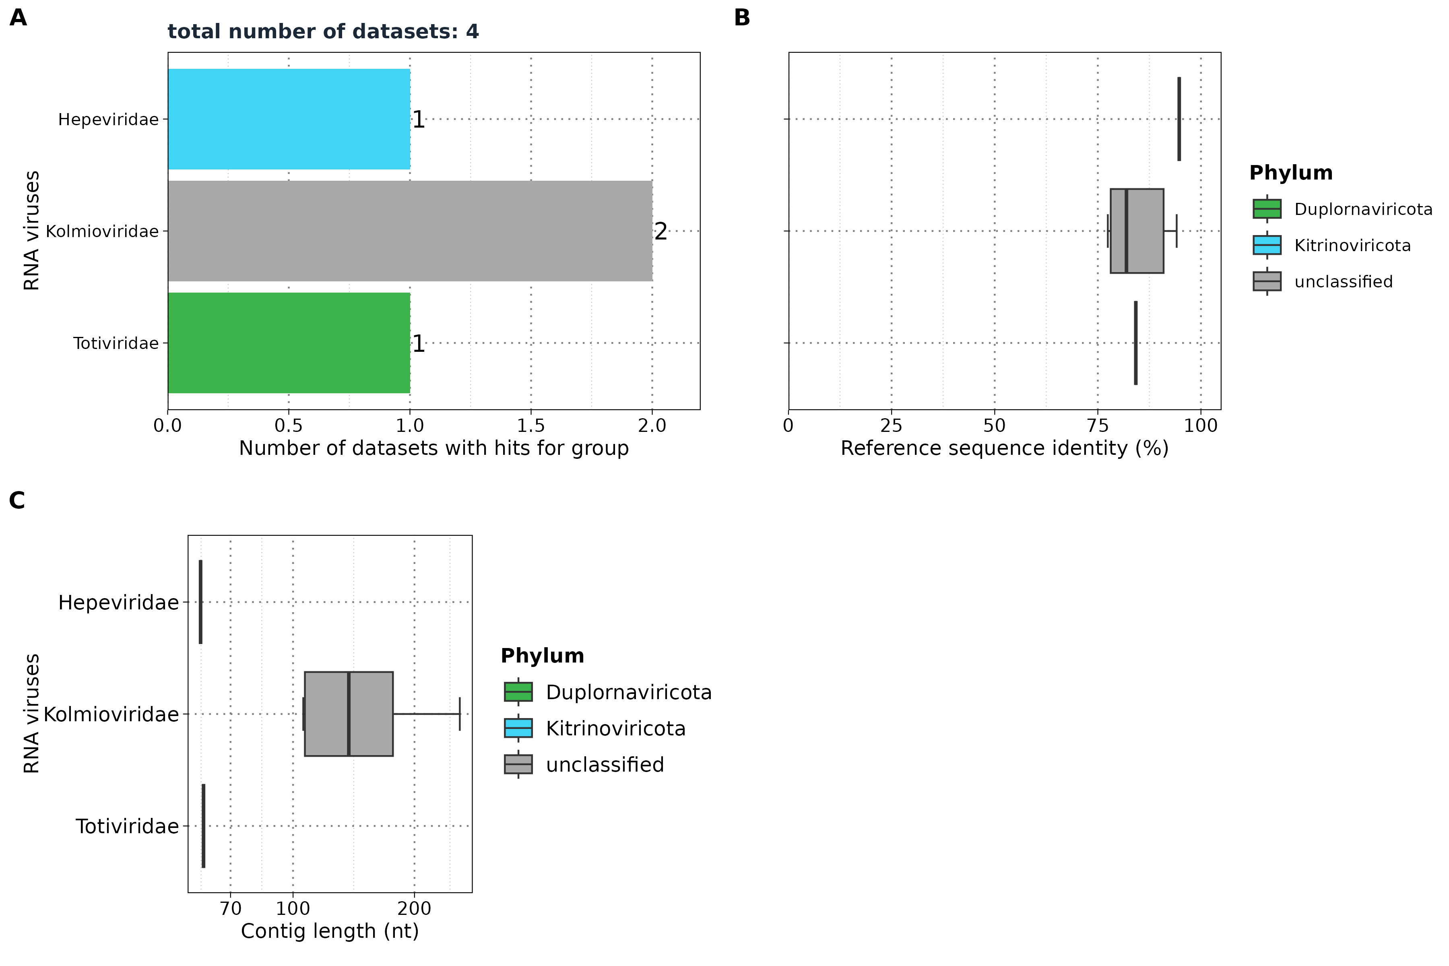
Results: Taubert
RNA viruses
Notes:
Viral Group entferen in dem B plot bei allen Datensätzen

Slide 16
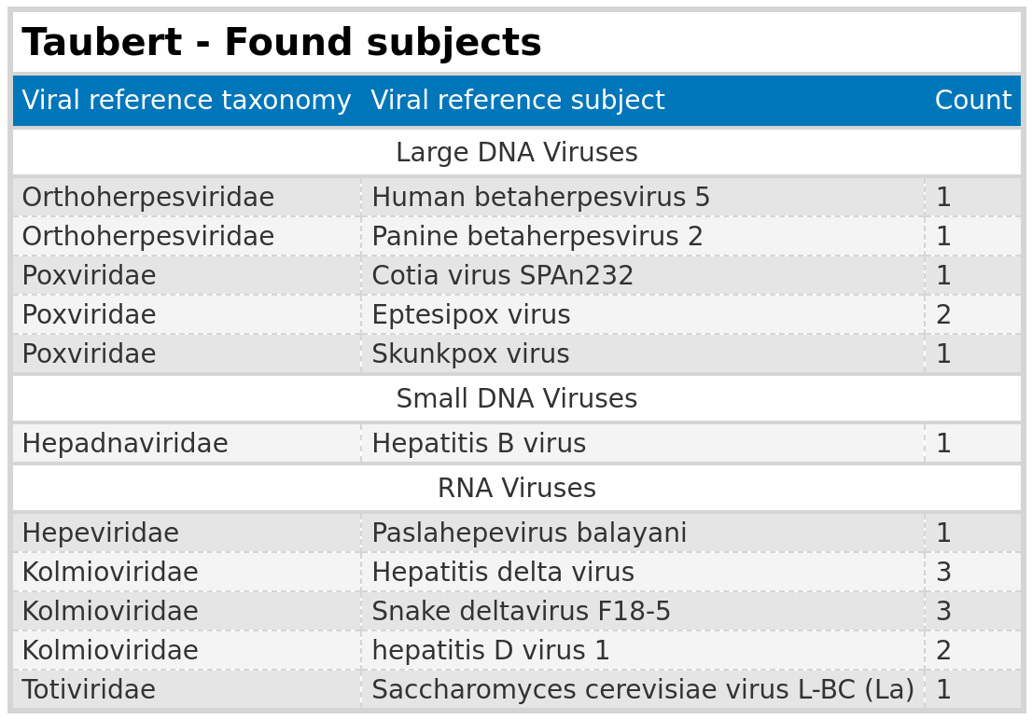
Results: Taubert
Subjects found
Notes:
The contig lengths are really short
Evalues are so low they are almost not significant,
But I extracted the subject reference virus to see what the contigs mapped to.
> We see totivirae maps against a yeast virus
> We have a snake deltavirus
> Poxviruses you find in bonobos,skunks and mice from brazil
> So most likely false positives.

Slide 17
Results: Taubert
Summary
Analysis Summary: Completed analysis of Taubert data for small DNA, large DNA, and RNA viruses
Data Overview: Out of 557 FASTQ files, only a maximum of 6 files yielded significant results
Significance Threshold: Significant results were close to the E-value cutoff of 1e-5
Contig Lengths: Identified contigs were all below 200 nt
False Positives: Detected false positive groups, such as Totiviridae (yeast virus)
Cross-Group Findings: Uroviricota appeared in RNA virus

Slide 18
Results: Mammal
Notes:
Next the results for the mammalian data

Slide 19
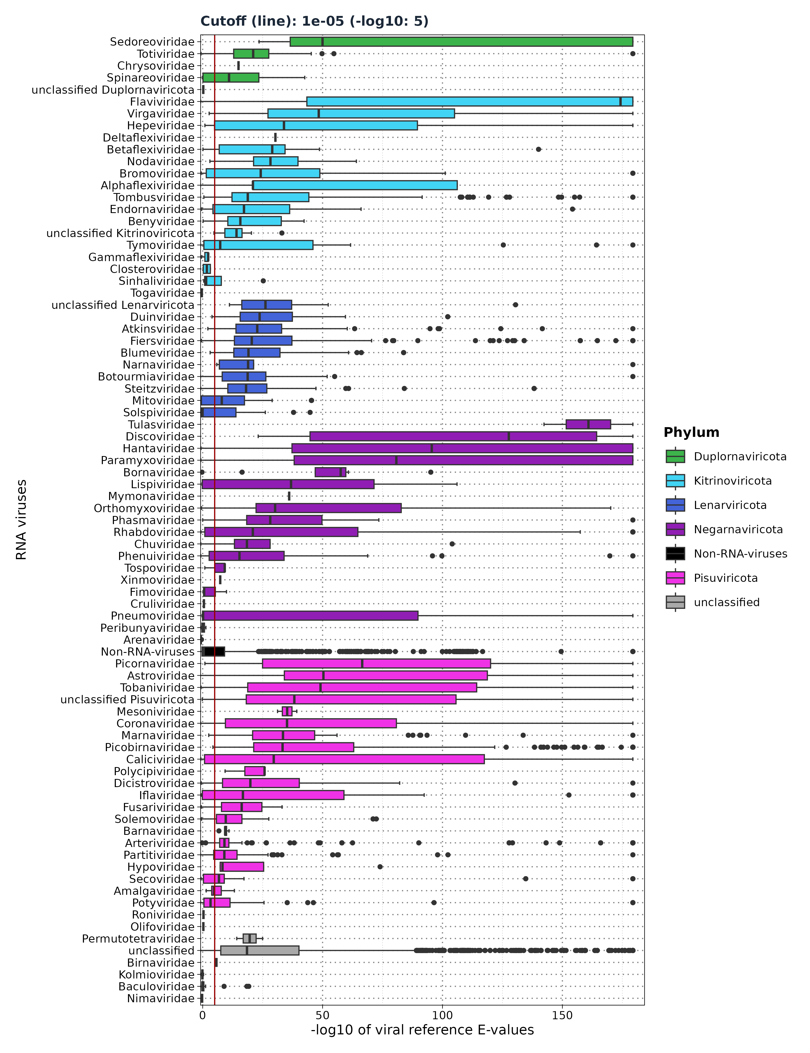
Results: Mammal – E-values
Viral reference E-values for
each viral groups
Cutoff: 1e-5
Notes:
Here we see the E-values.
> I combined all 6 groups into one after running vhvg seperatly for each group.
> We use the same cutoff
> Flaviviridae has the highest median with extremly low E-values for 50 % of the data.
> Followed by Astroviridae.
> The median difference between first place and second place is large.
> 3 dominant phyla: Pisu, lena and kitrinoviricota
> We have values below the threshold such as baculoviridae with only 2 outliers being above.

Slide 20
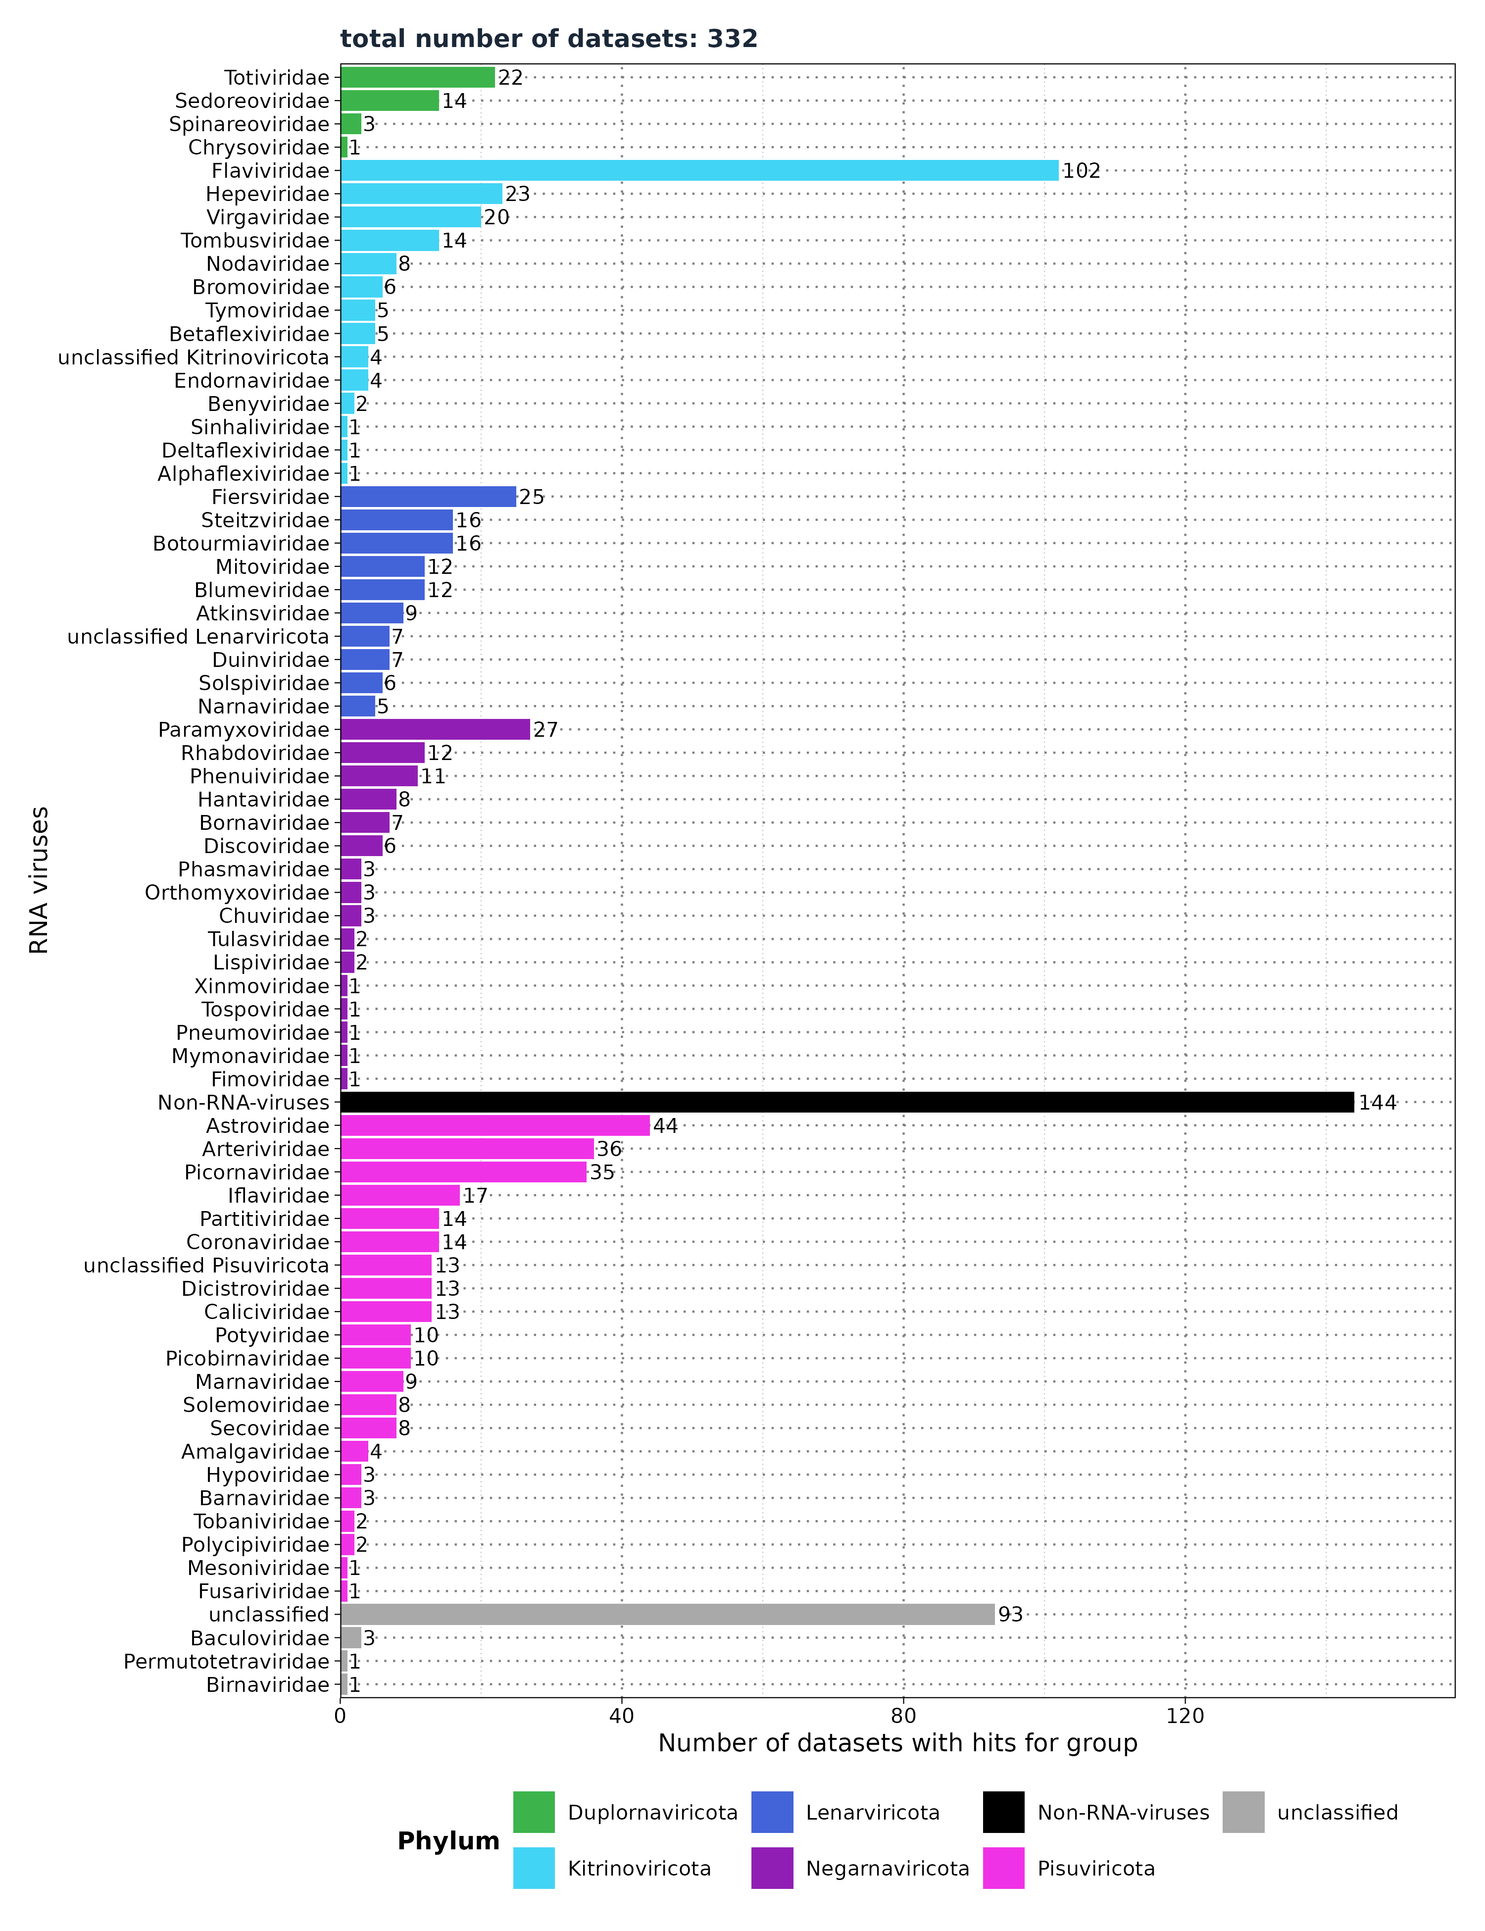
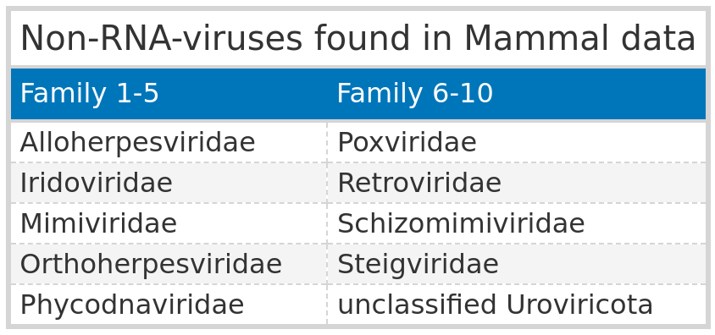
Results: Mammal
Distribution of groups across queries
Filtered for significant observations (E-value < 1e-5)
Notes:
> Here again I show only the significant results above the cutoff
> We see that 274 unique datasets exist
> Just like uroviricota in Taubert dataset we have non-rna viruses in this dataset.
> I clustred them into 1 group and found 25 non-rna virus families you see in the table.
> followed by ….

Slide 21
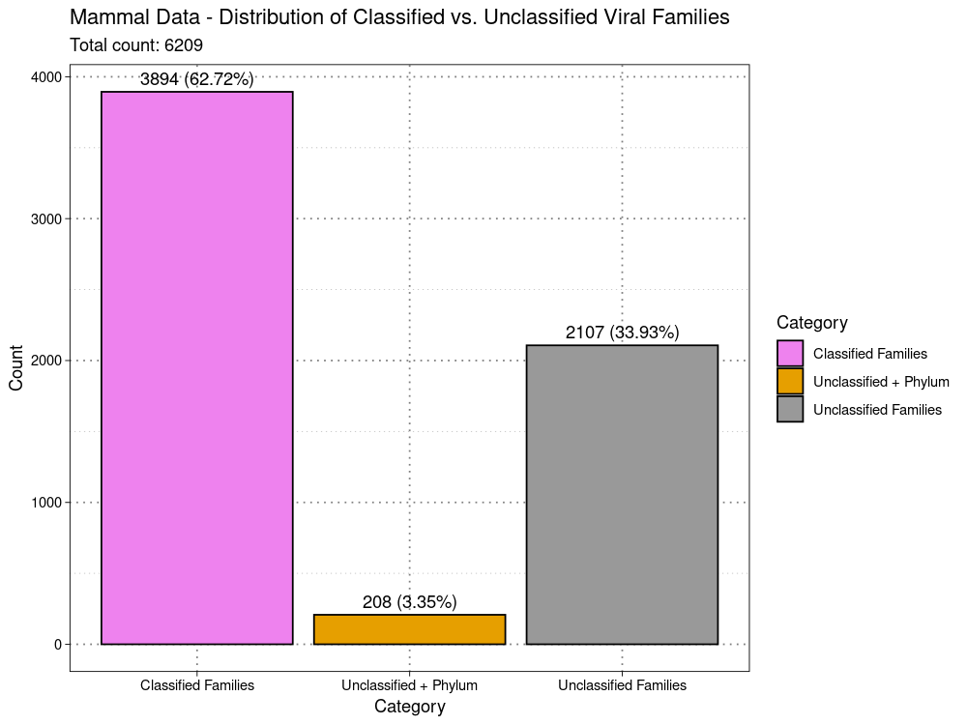
Results: Mammal
classified vs unclassified
Viral Family extracted from
ViralRefSeq_taxonomy column
- 5310 observations for 274 unique SRA IDs.
Notes:
In the last slide you saw that 70 datasets found unclassified.
> That means the viral family was not available in the taxonomy column.
> VirusHunterGatherer just failed to fetch them or fetched other taxonomic information except the family.
> I wanted to know how many observations are unclassified 1/3 of all observations > 1 Dataset can find more than 1 virus > more observatiosn

Slide 22
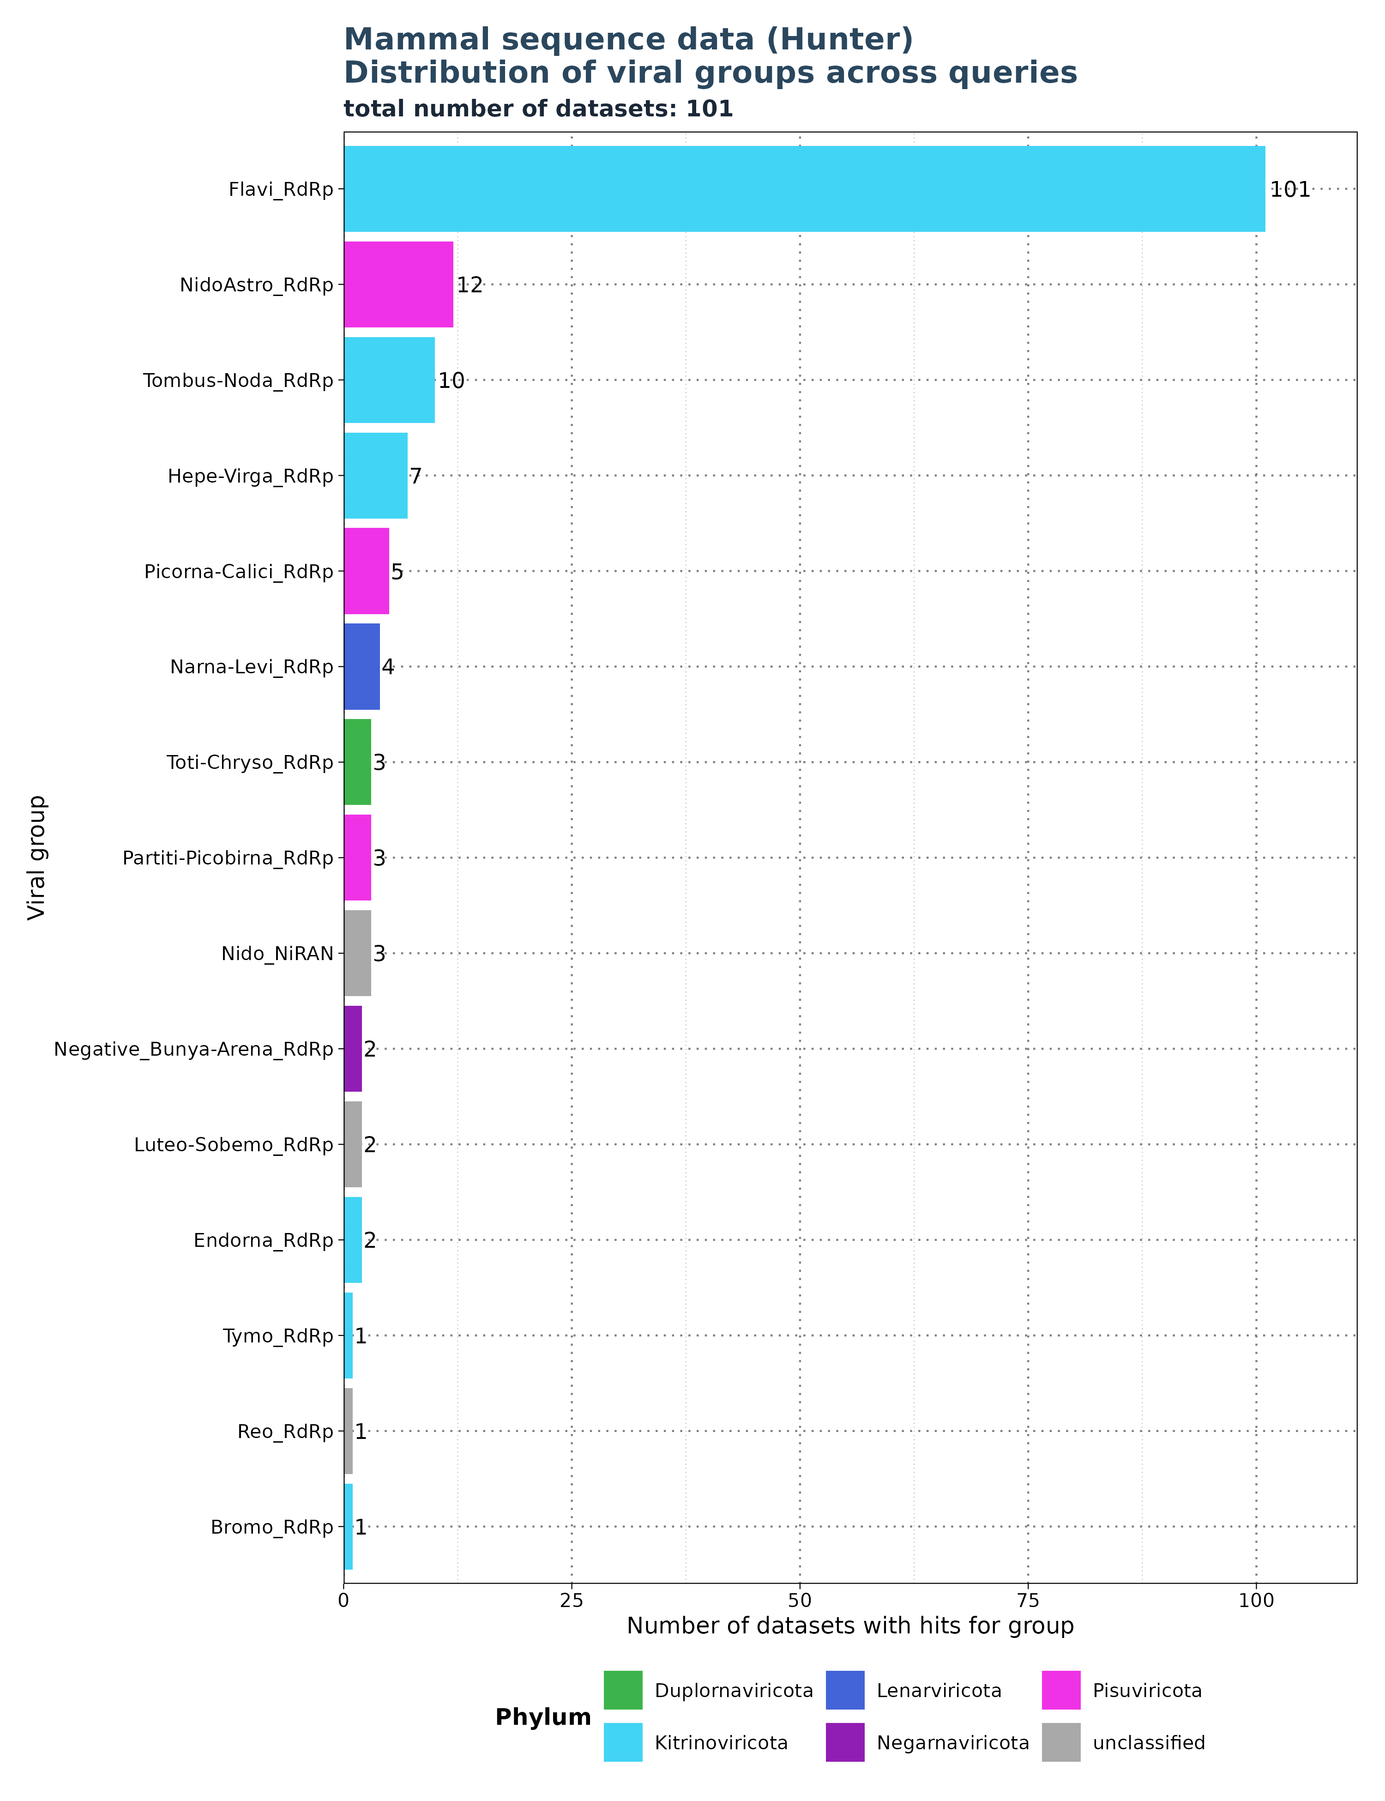
Results: Mammal
Non-Family Specific Profiles
Search for: Flavi_RdRp
Notes:
> Profile search is not specific
> Plot: Hunter results for Flavi_RdRp
> Find Flavi in all data sets, but find also others
> Find also Hepe and Bunya → Flavi contributes to other groups and vise virsa → inflates the numbers

Slide 23
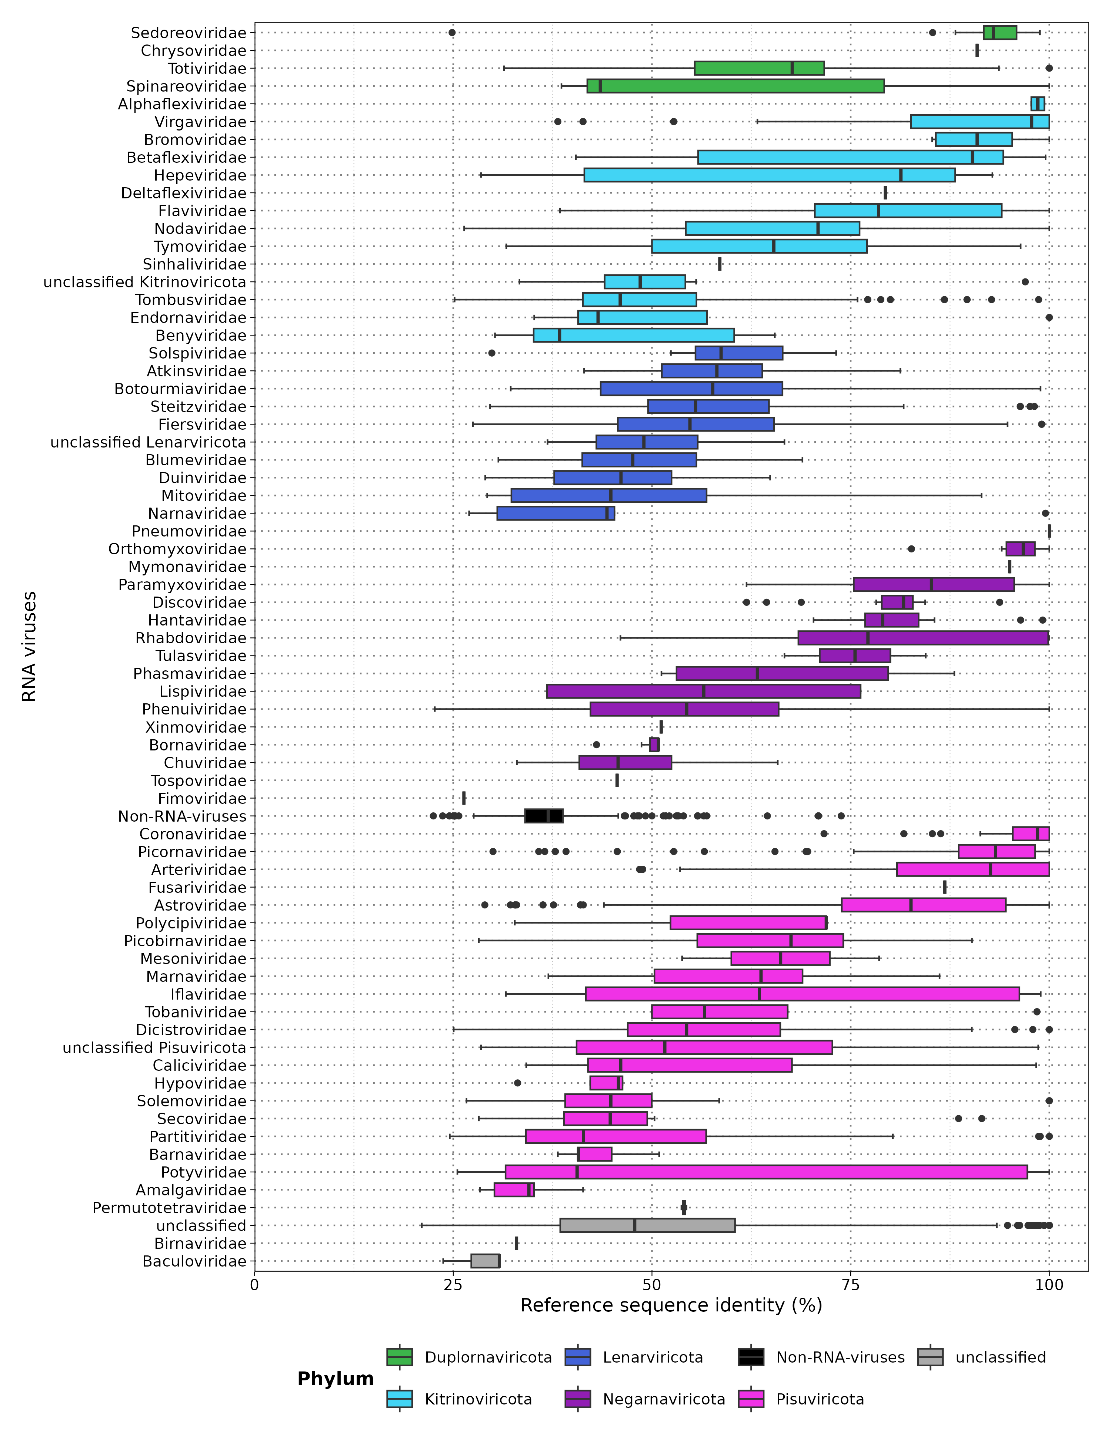
Results: Mammal
Identity
Filtered for significant observations (E-value < 1e-5)
Notes:
Here we see the % identity against the viral Refrence
> Coronavirus have high identity % to the refrence and are most likely not novel viruses.
> On the other side.We see that flaviviridae has a median of 78 %

Slide 24
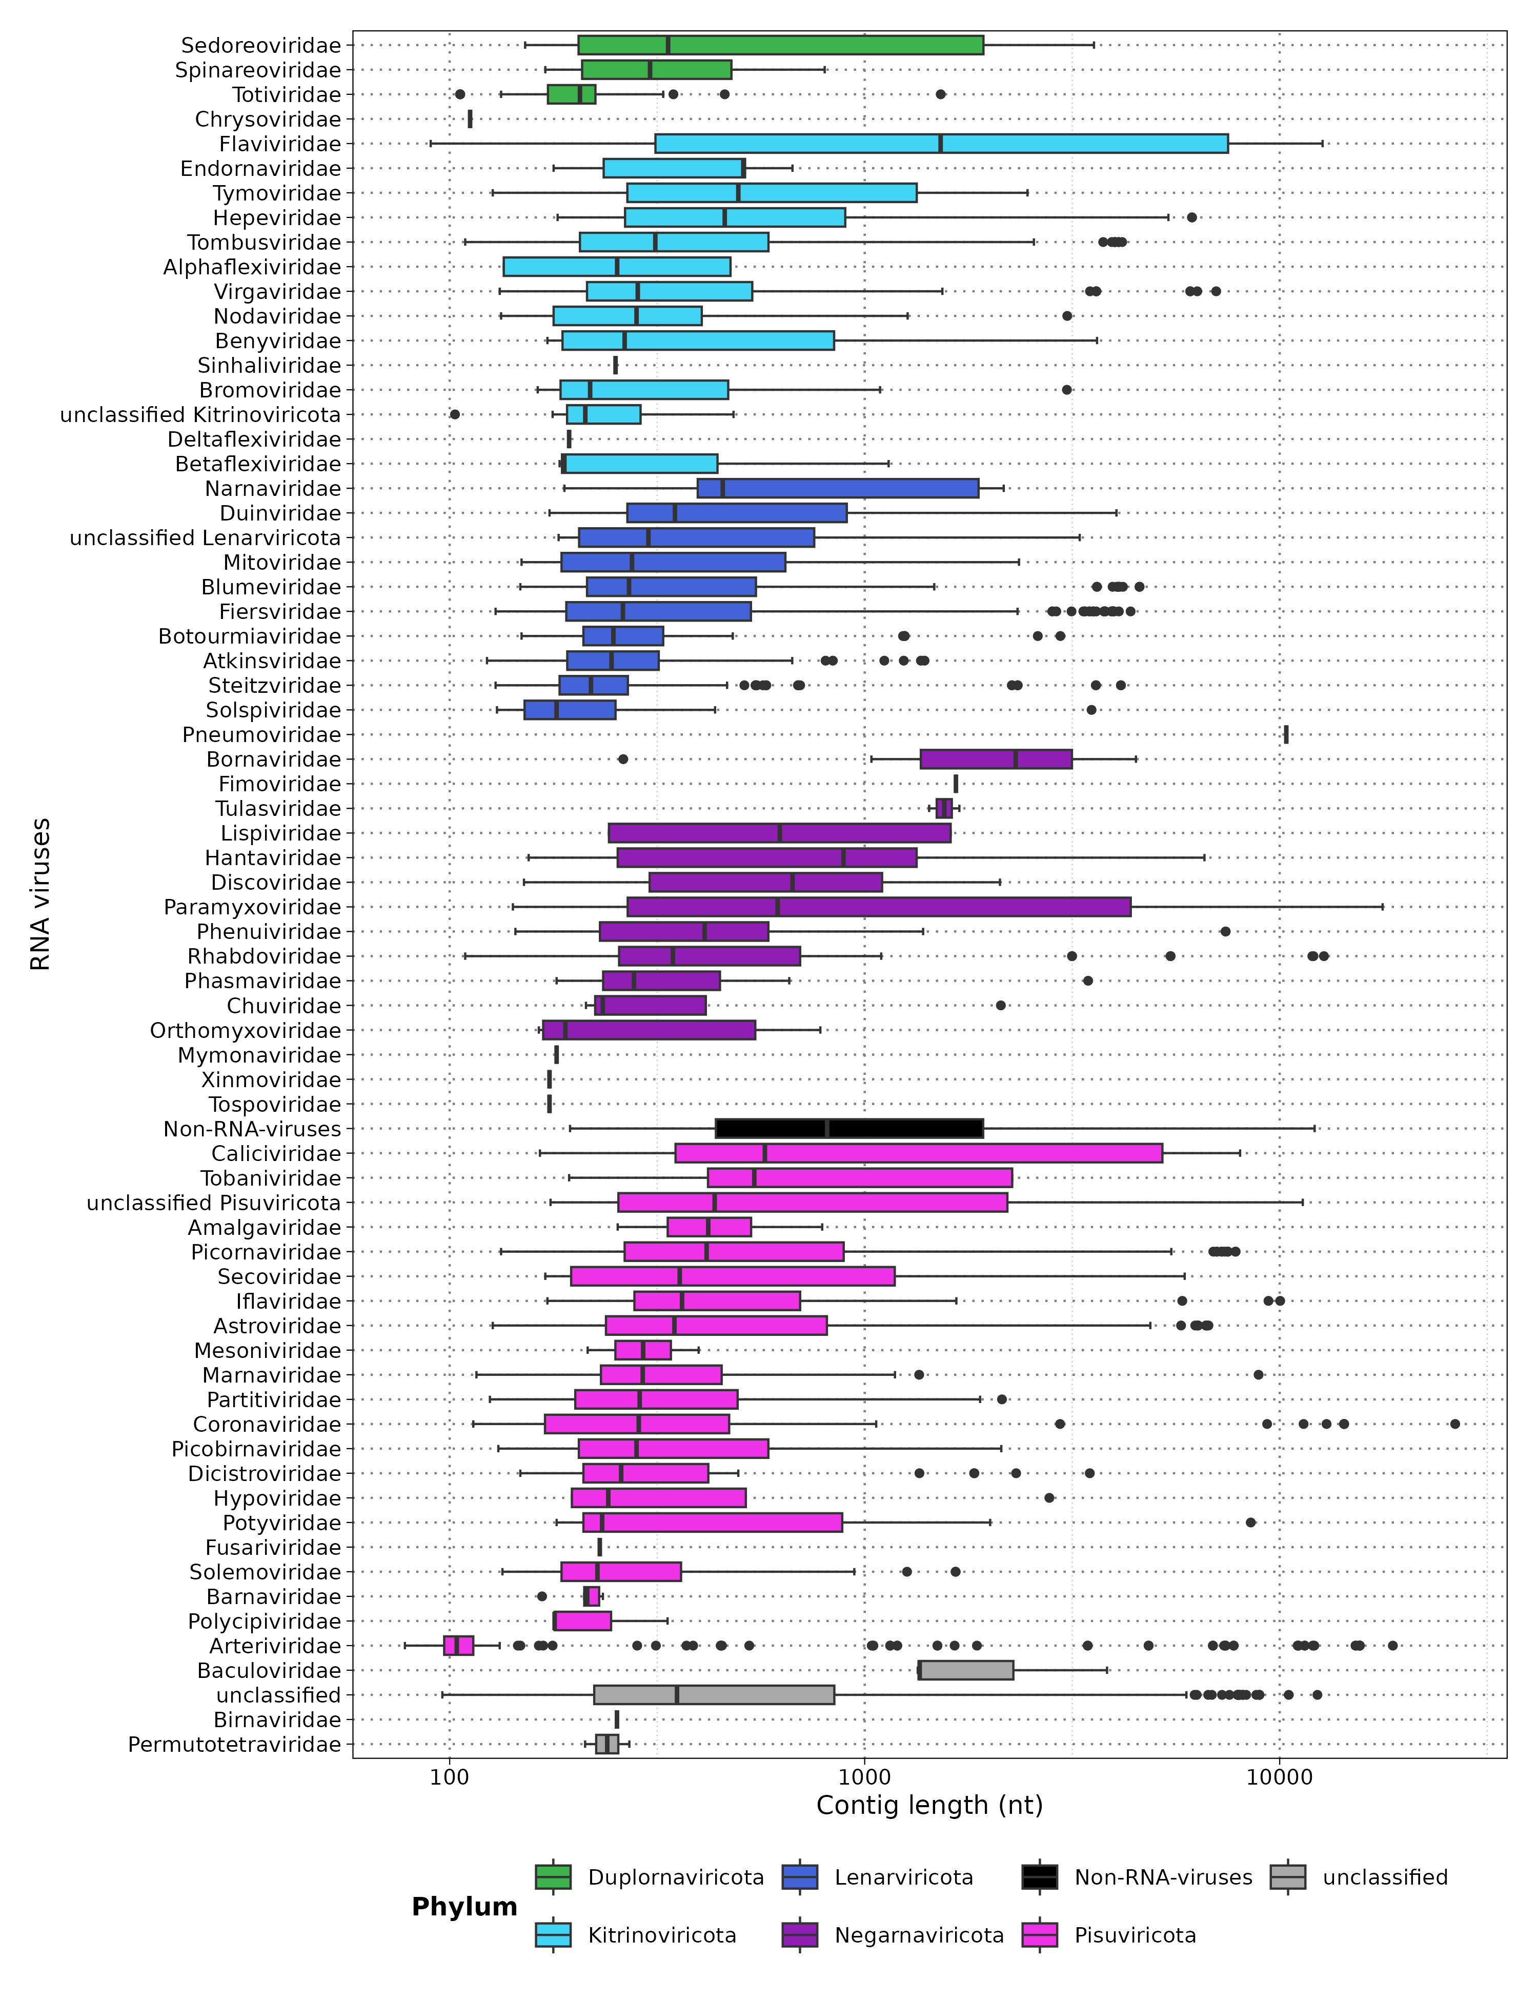
Results: Mammal
Contig Length
Filtered for significant observations (E-value < 1e-5)
Notes:
Here you see the contig length on a log 10 scale.
> baculoviridae → only 2 data points
> Flaviviridae → whole spectrum. 90 -13.000 with a median of 1500
> Picobirnaviridae in the middle with 130 -2000
> Asterviridae is last, where majority are short contigs with outliers being huge.
> Next I wanted to see what the noverl viruses are and which subjects they find.

Slide 25
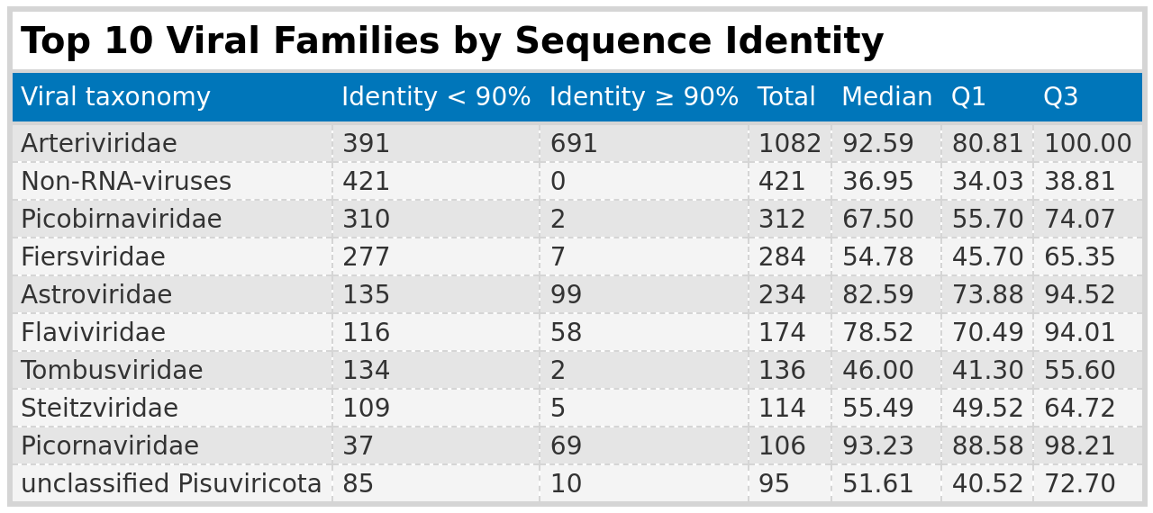
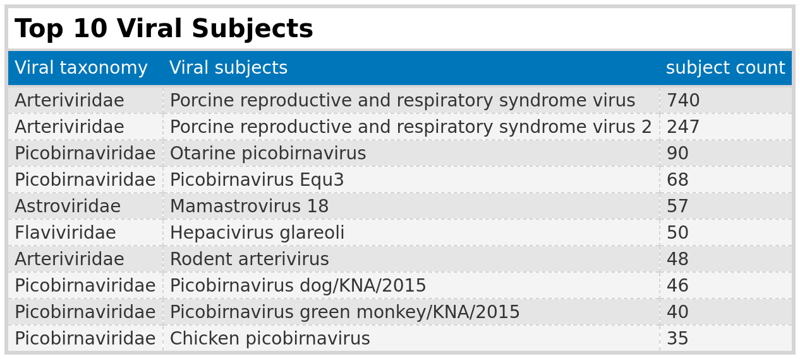
Results: Mammal
Notes:
To see the top 10 potentially novel viruses I seperated them into groups below and above 90 and sorted the top 10 by total.
> I took those 10 groups and filtered for top 10 subjects.
> There are more subjects (1000) but we have to go through them to find something. I just sorted the top 10.

Slide 26
Results: Mammal
Summary
Classification Issues: 36% of viral taxa could not be classified due to missing information on viral families
Cross-Group Findings: 25 non-RNA viruses were identified
Profile Specificity: profiles are not specific to one family
Flaviviridae:
Data Sets: 102 (174 obs.)
Identity: 67% < 90%, median 78%
Contig Length: 90 - 12,688 nt, median 1,524 nt
Arteriviridae:
Data Sets: 36 (1,070 obs.)
Identity: 35% < 90%, median 94%
Contig Length: 87 – 18,735 nt, median 104 nt
Picobirnaviridae:
Data Sets: 10 (312 obs.)
Identity: 99.4% < 90%, median 67.5%
Contig Length: 131 – 2,134 nt, median 282 nt
Notes:
Flaviviridae > Appears in most datasets with low identity and large contig lengths
>Arteviridae with the most observations in the dataset, extreme differences in contig length and most subjects found.
> Picobirnaviridae → 99 % of identity below 90 % and contributing 50 % of subjects in top 10.

Slide 27
Results: Florian Pfaff

Slide 28
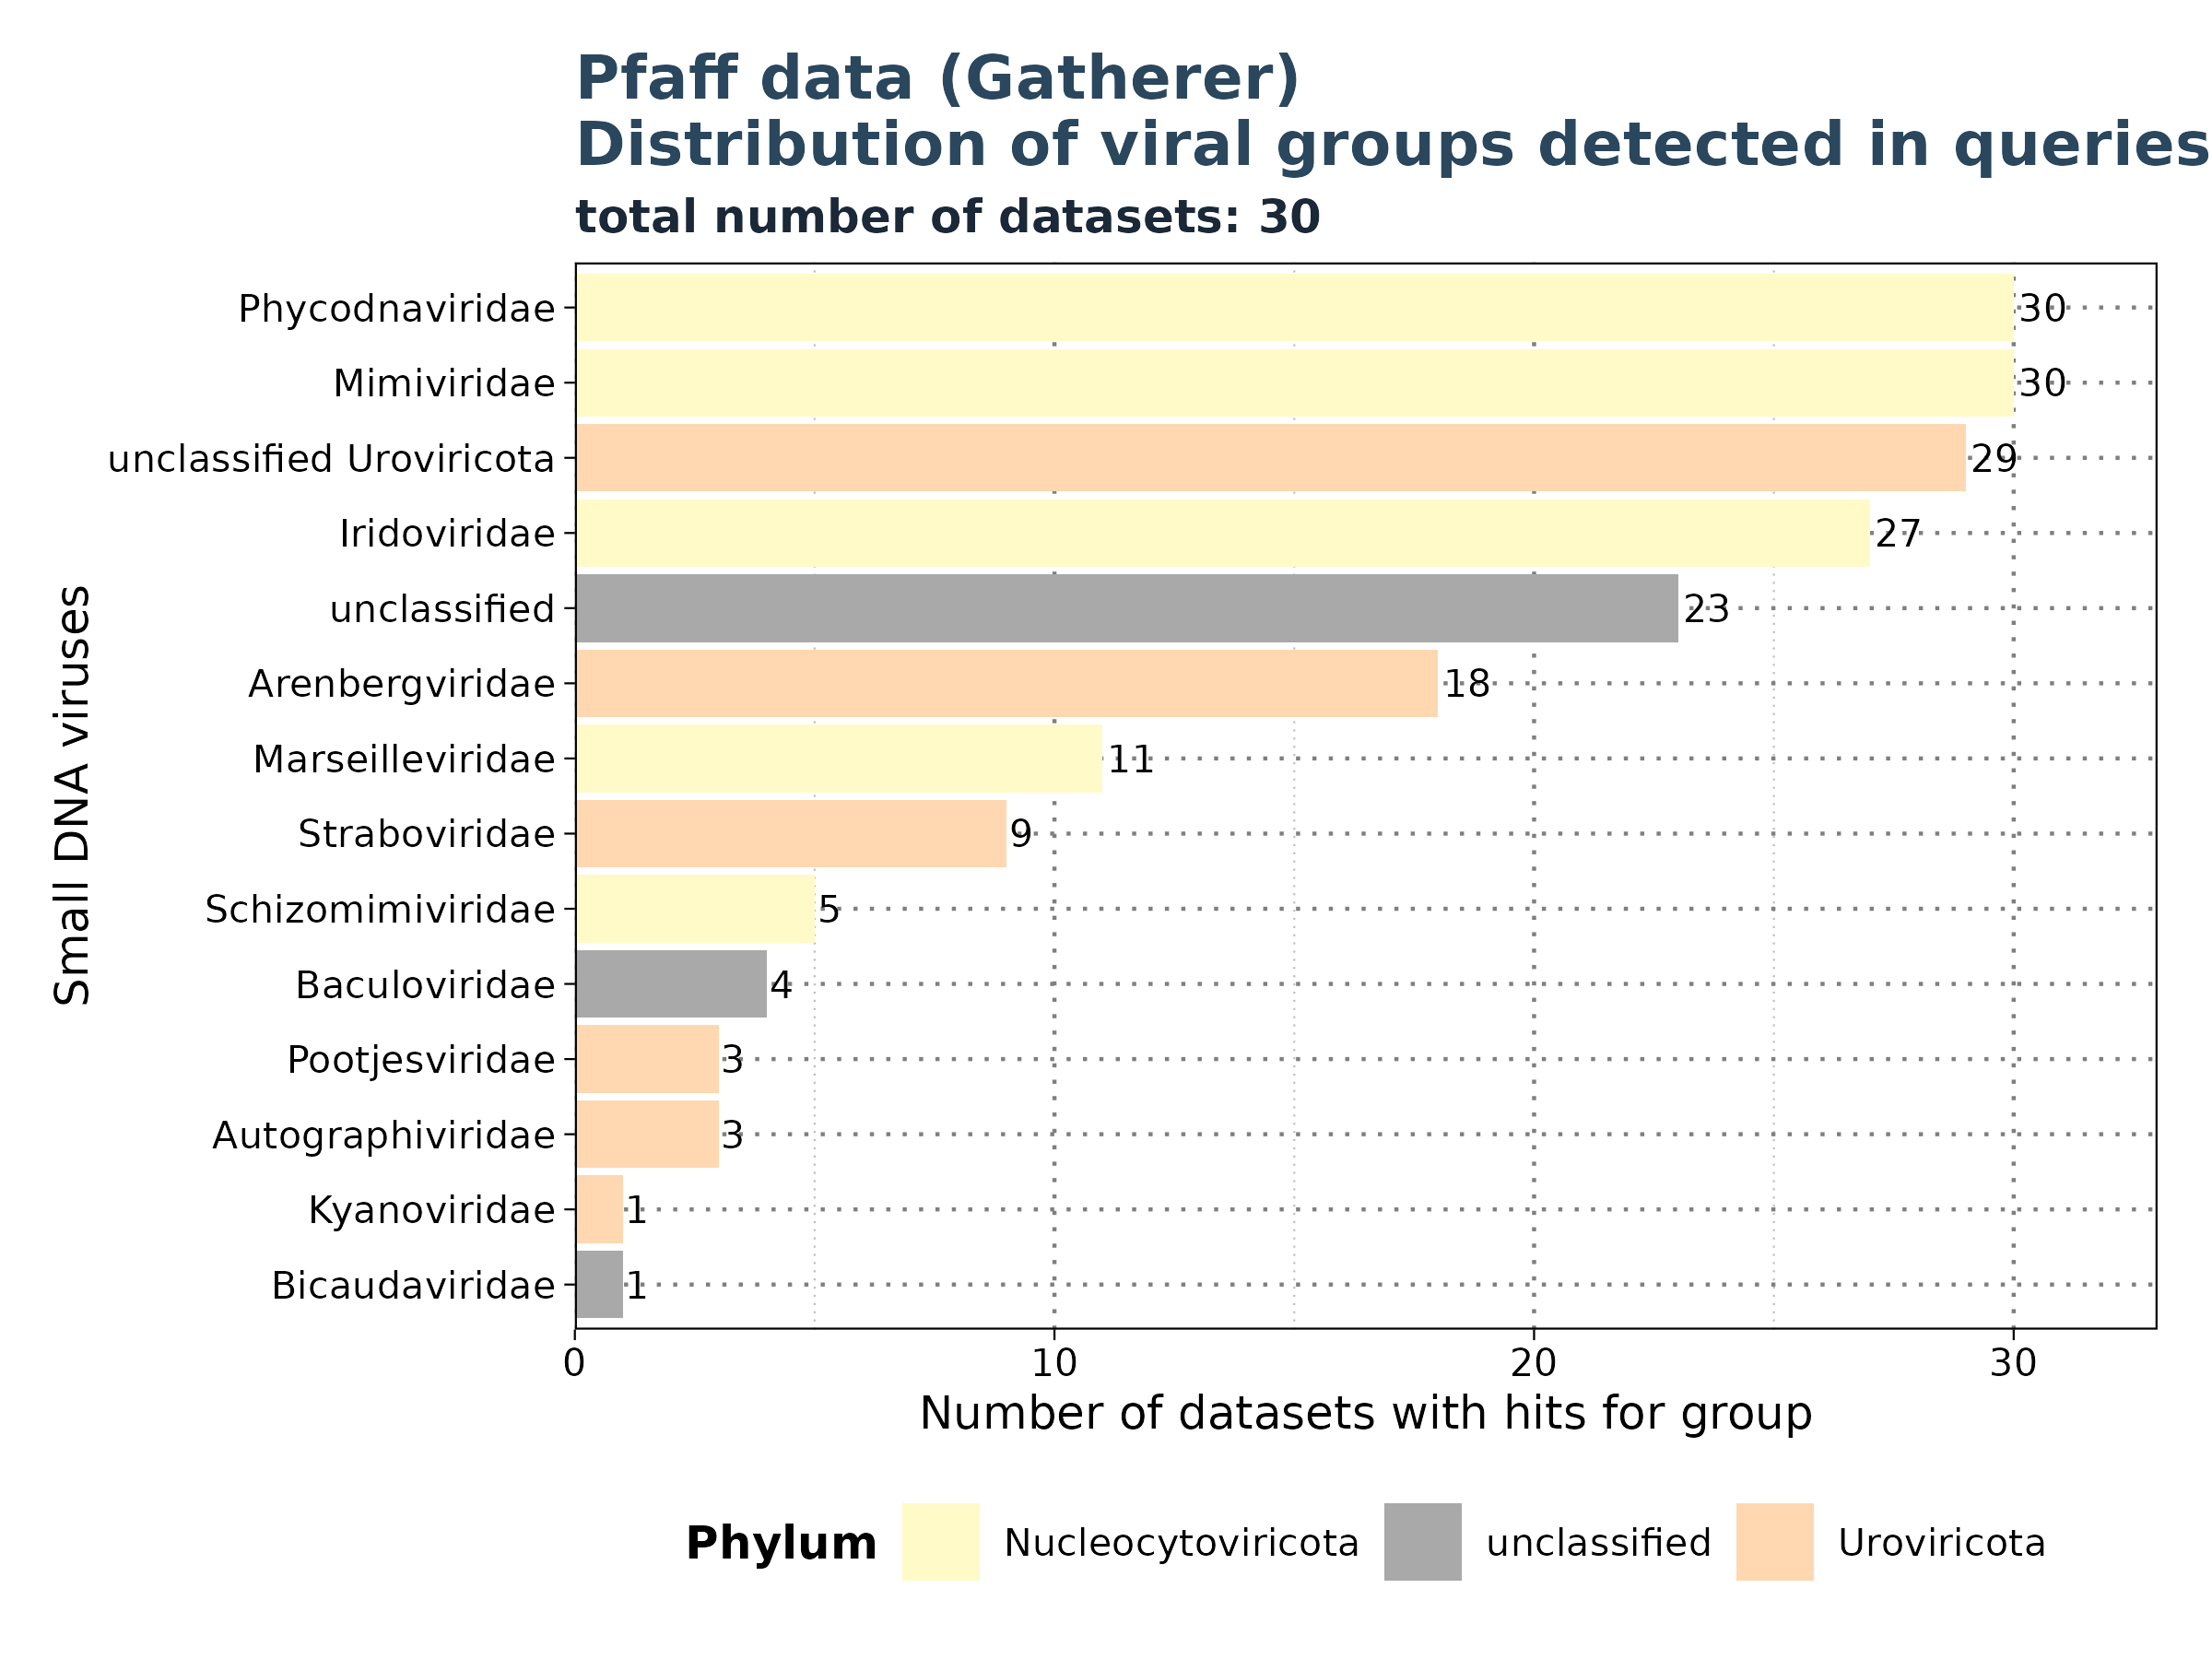
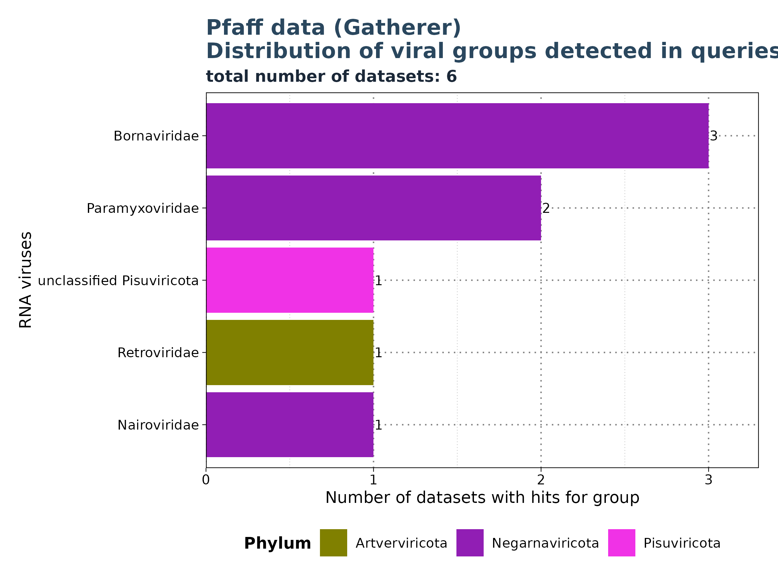
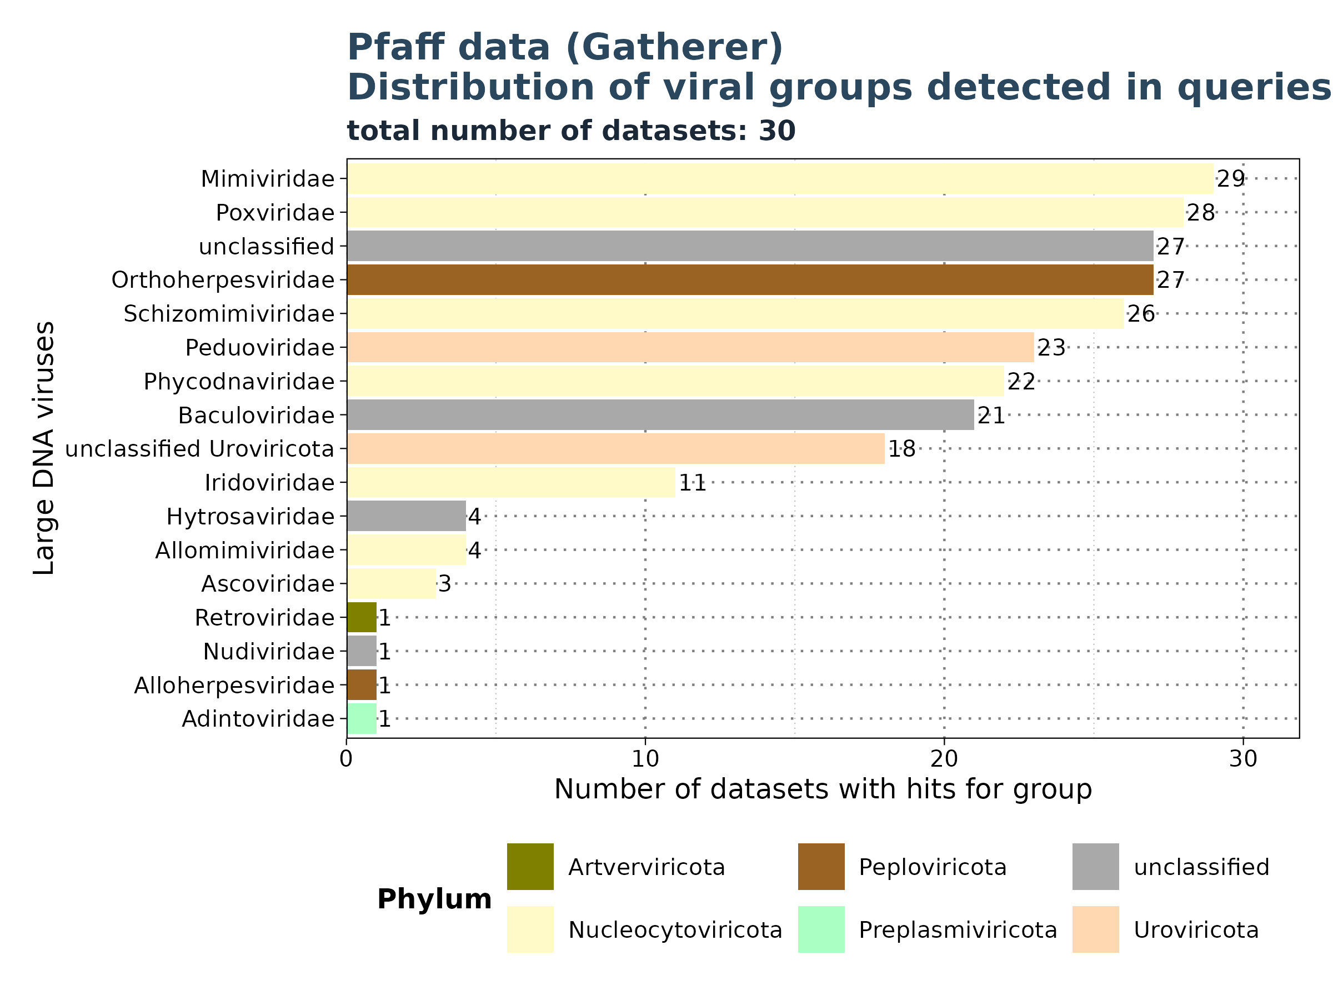
Results: Pfaff Data
Distribution of groups across queries
Filtered for significant observations (E-value < 1e-5)
Notes:
Here we I will go fast through the Florian Data set since its not part of my master thesis.
> One thing I want to point out
> We have again we have a cross group findings:
We find Mimivirae and Phycodnaviridae in both small dna and large dna as significant results.

Slide 29
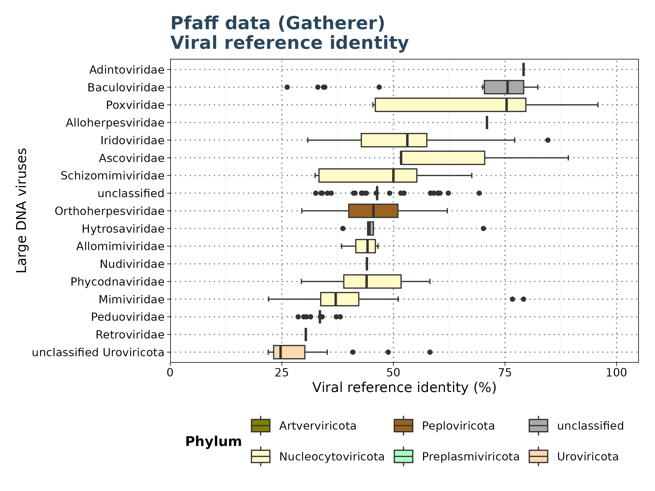
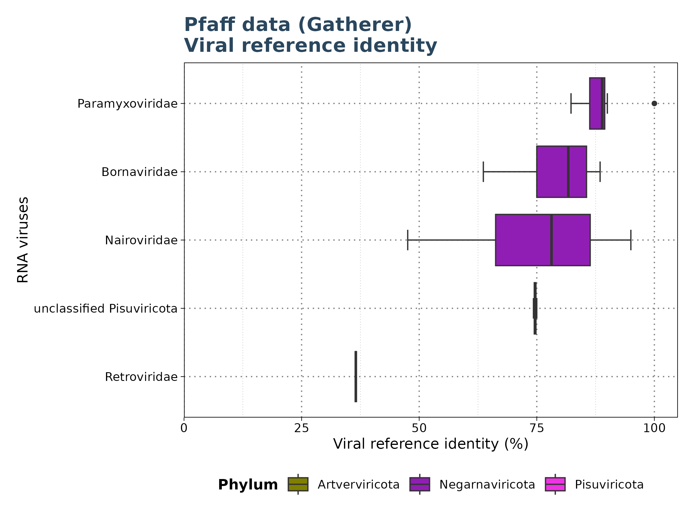
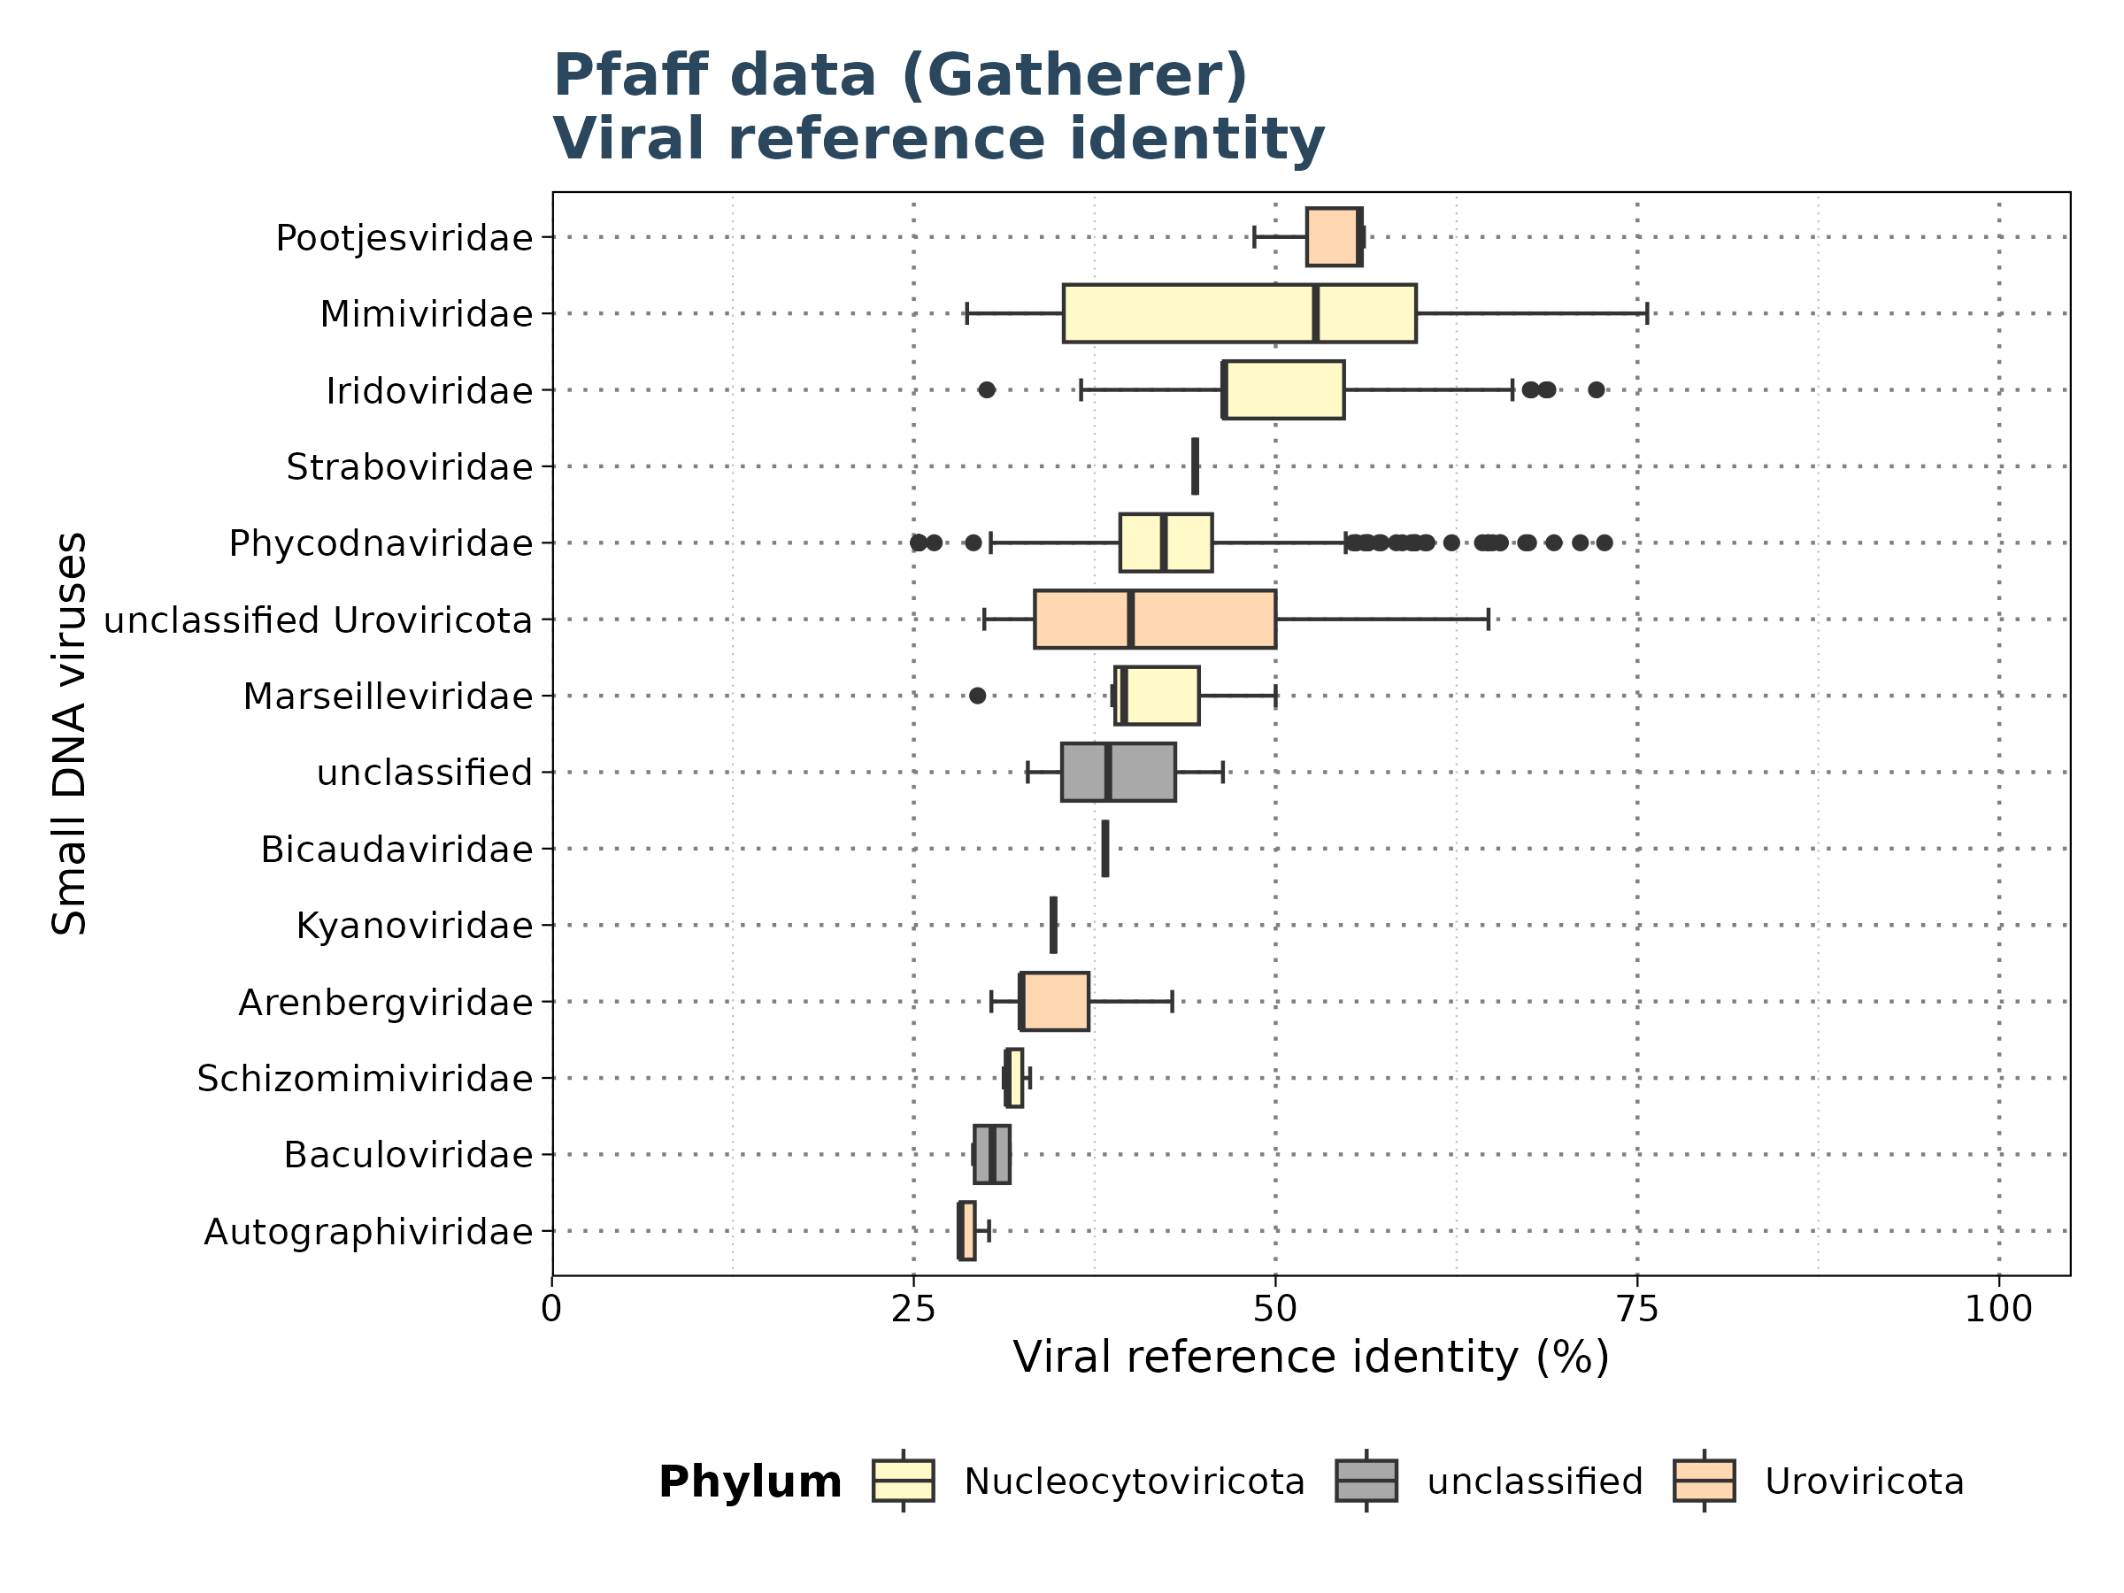
Results: Pfaff
Identity
Filtered for significant observations (E-value < 1e-5)

Slide 30
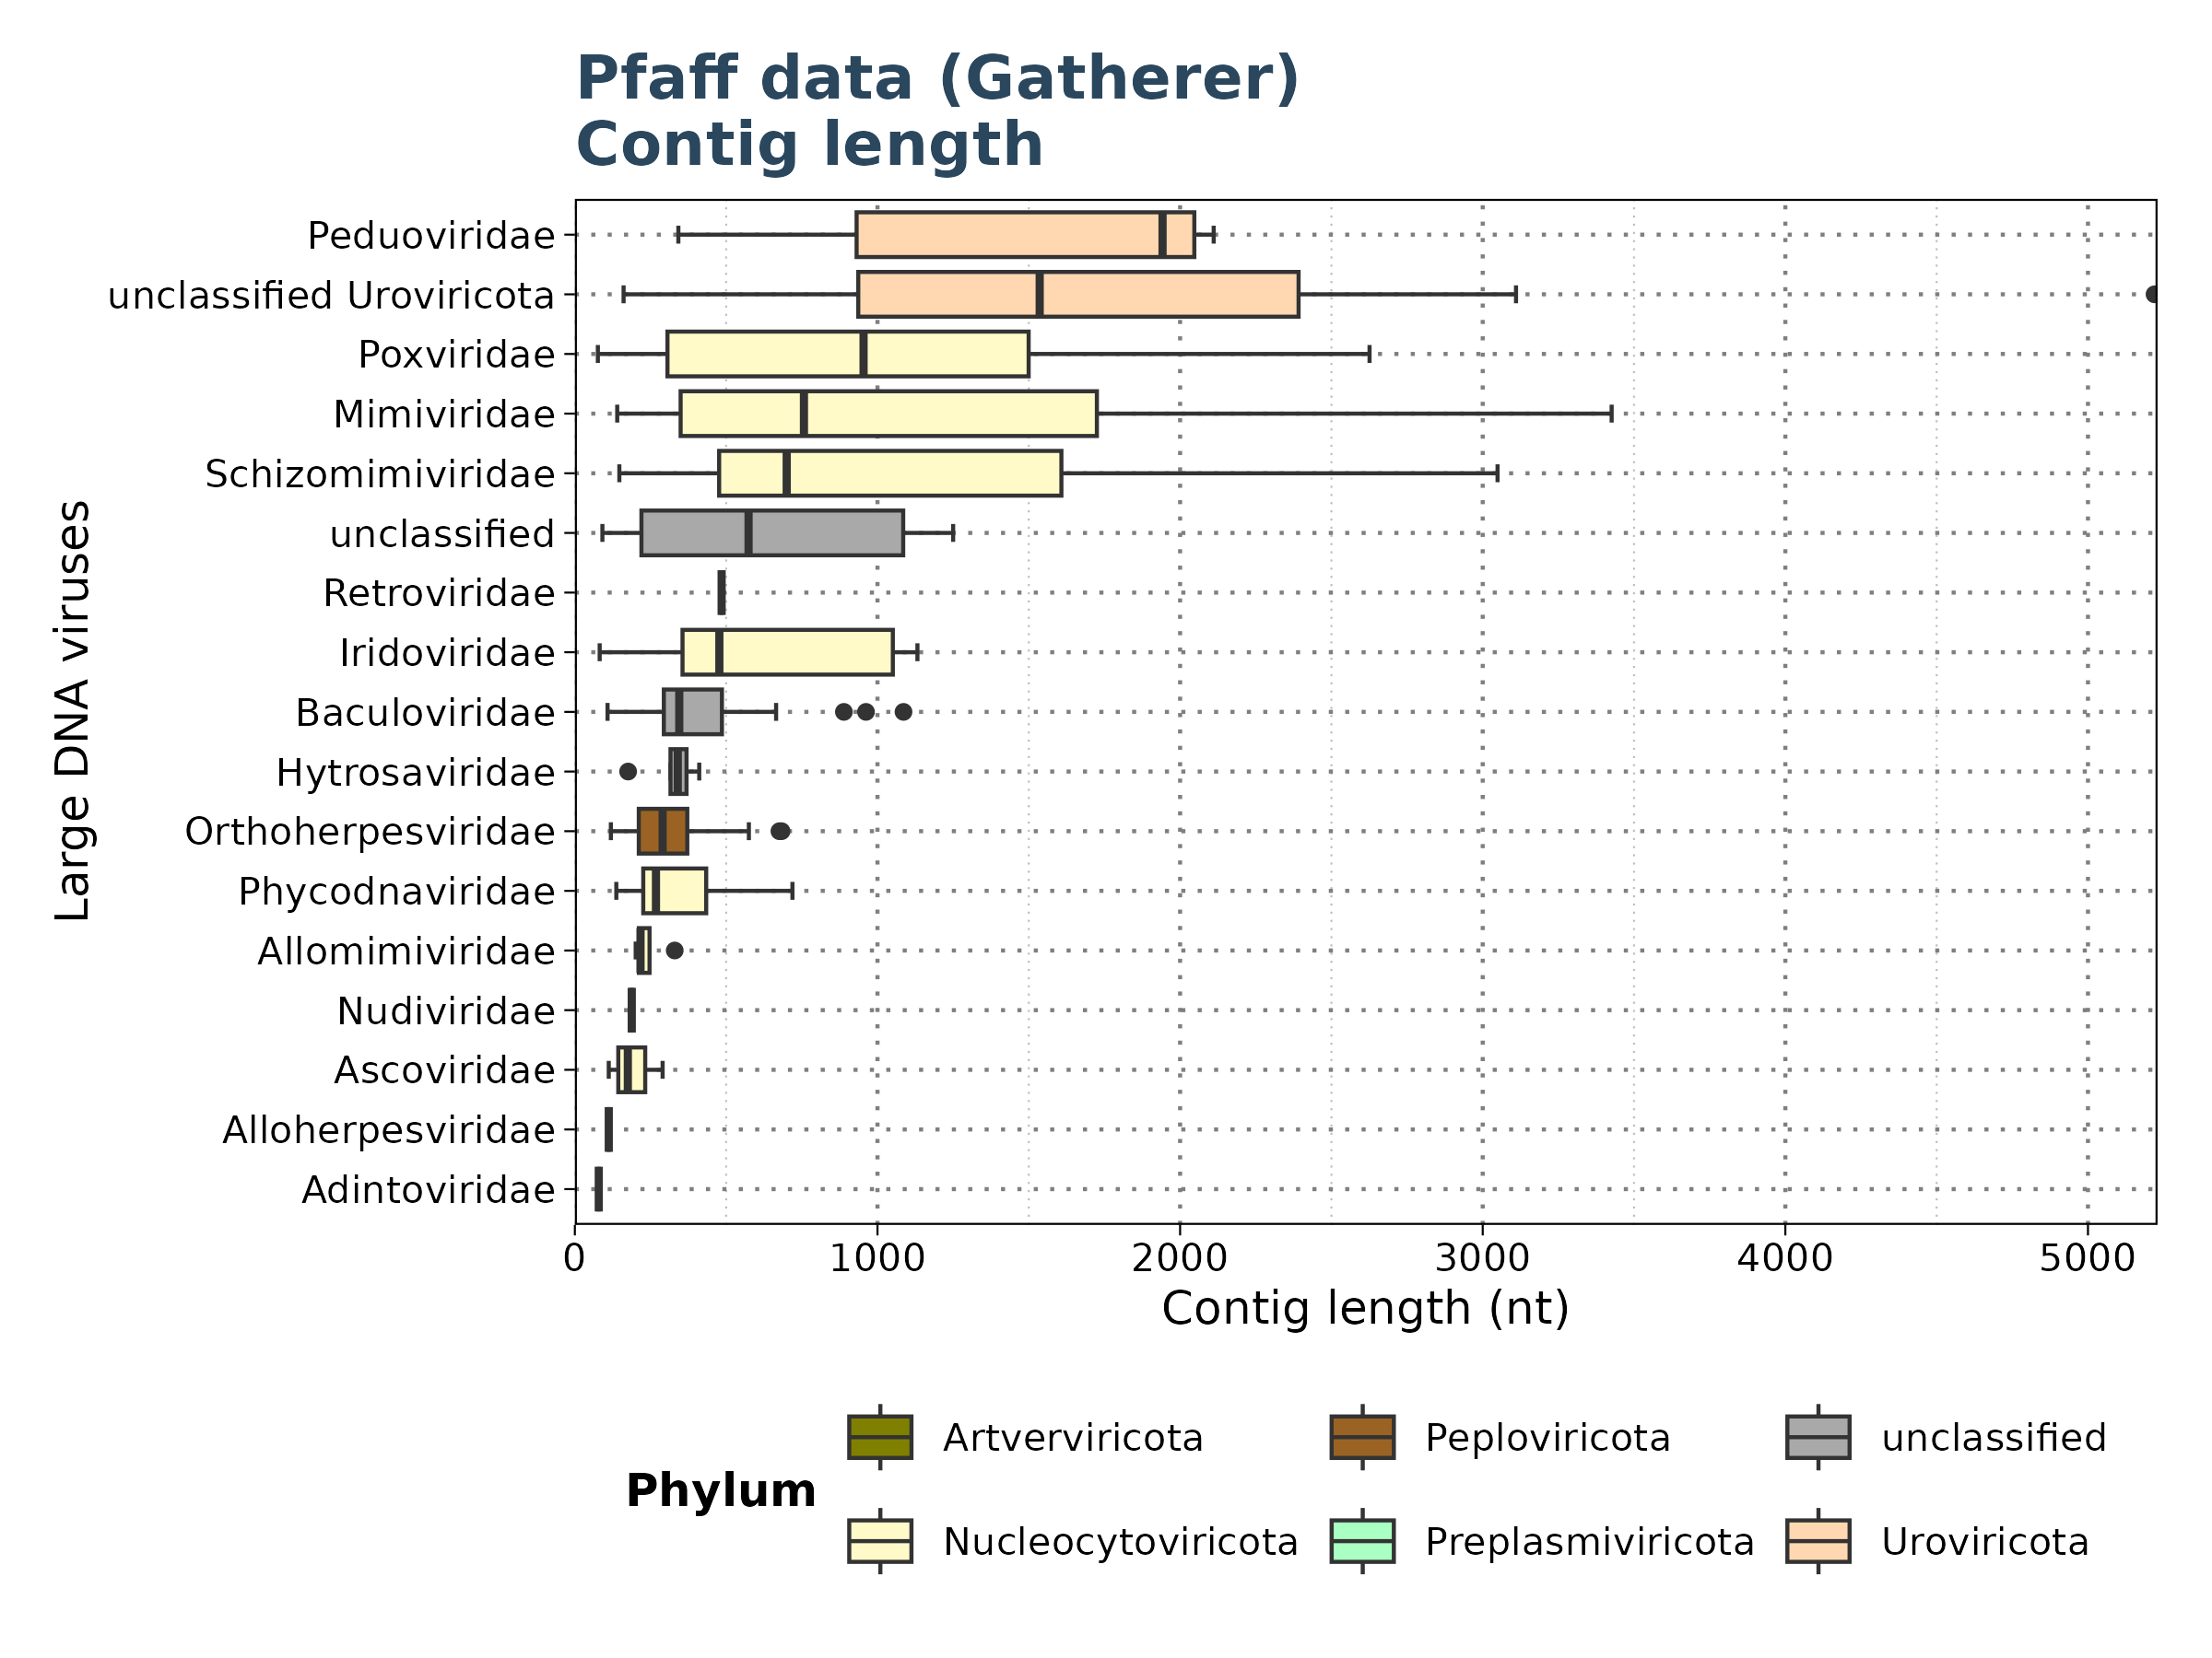
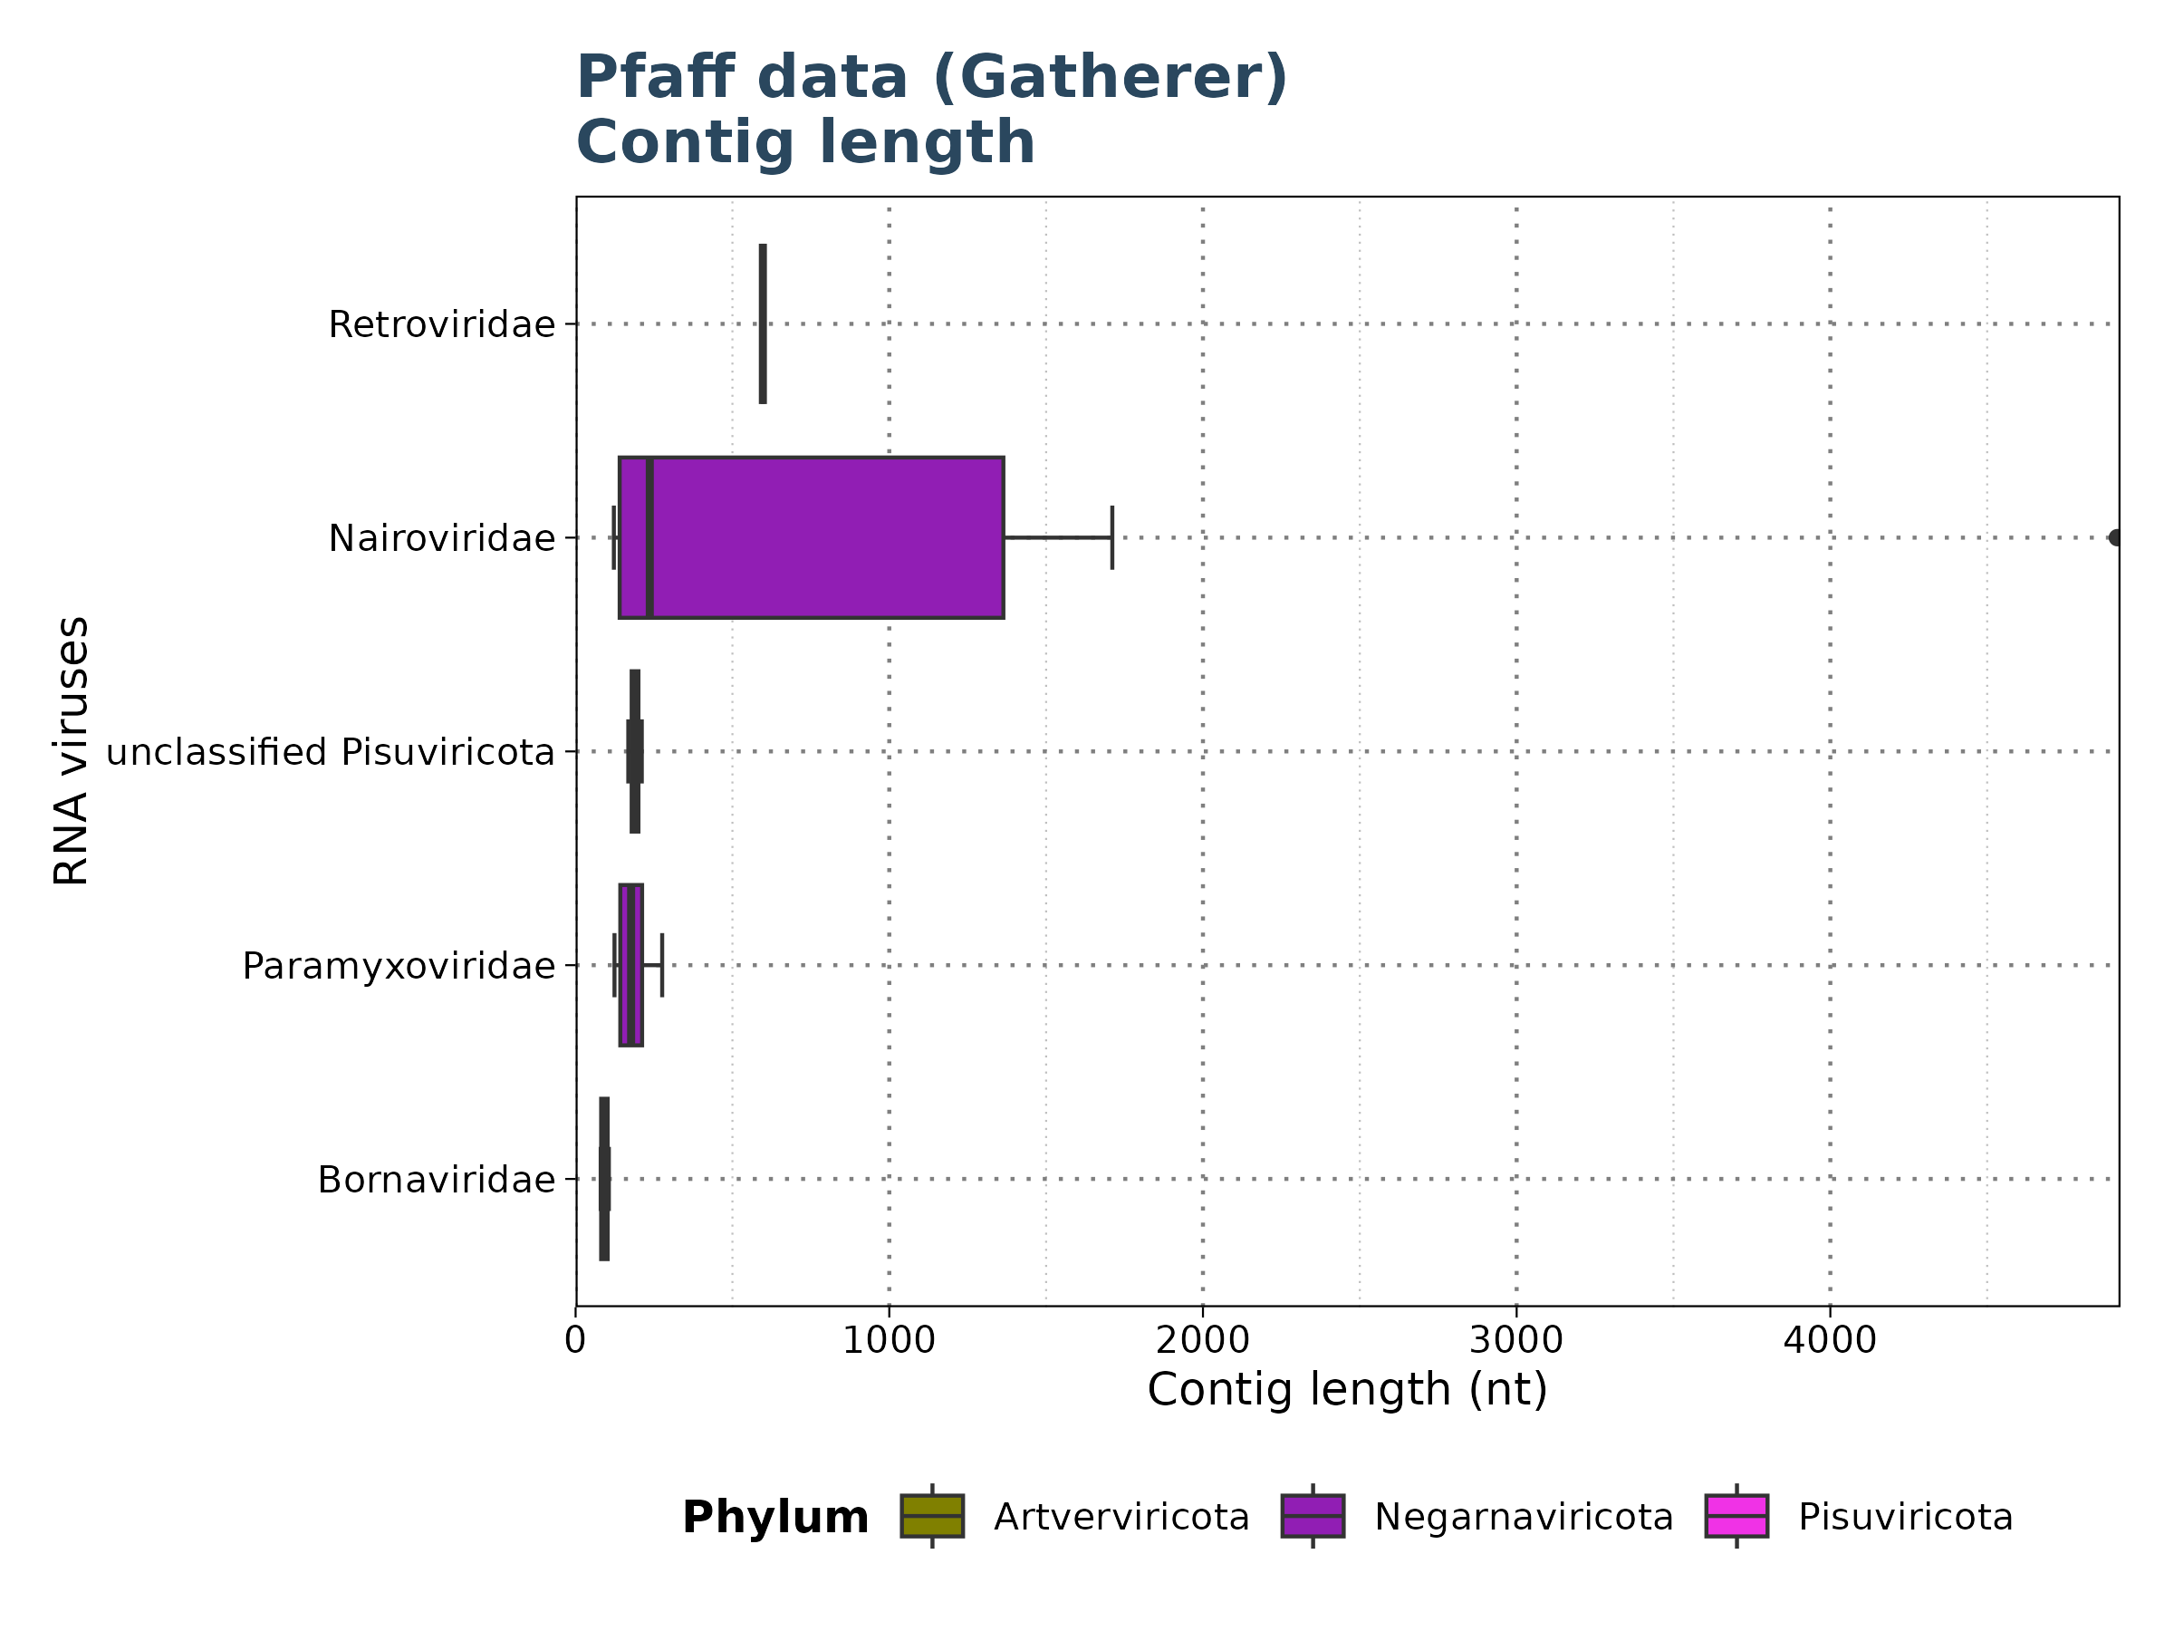
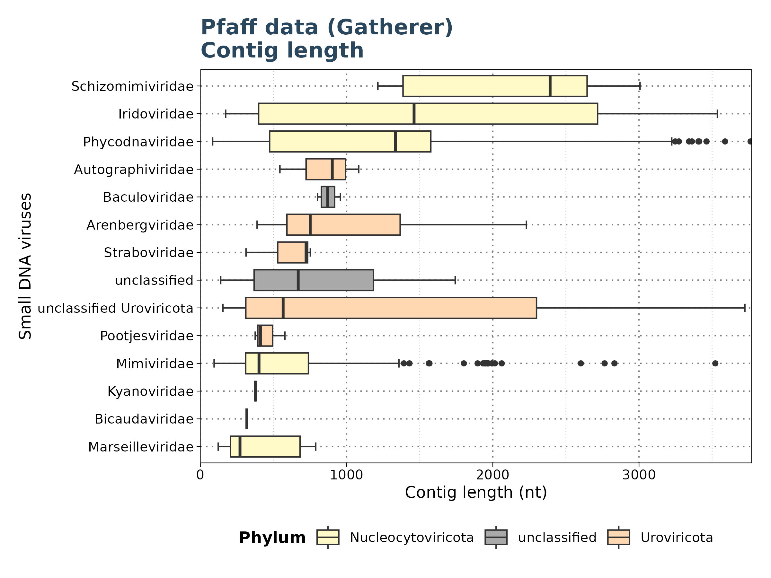
Results: Pfaff Data
Contig Length
Filtered for significant observations (E-value < 1e-5)

Slide 31
Results: Pfaff Data
Summary
Comparison of Taubert and Pfaff Data:
Pfaff Data: 30 out of 32 files yielded significant results
Taubert Data: Only up to 6 out of 557 files showed significant results
Note: Potential impact of Taubert data not being preprocessed for viral discovery?

Slide 32
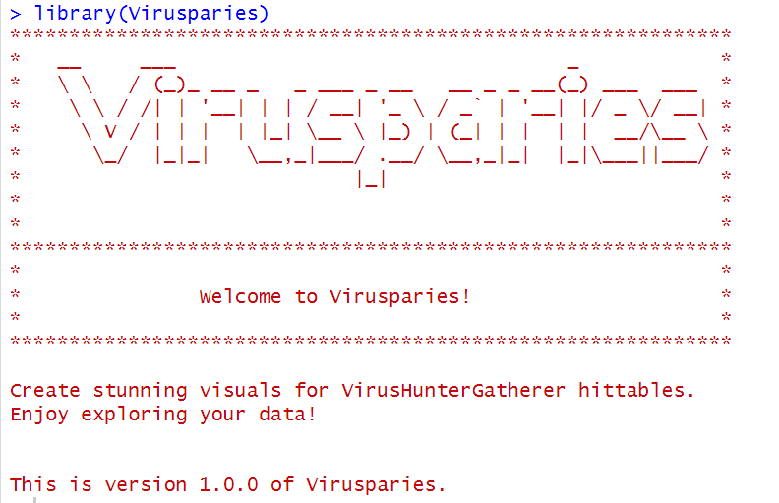
Results: Virusparies
18 Functions:
1 function to import hittables
6 plot functions (box plots, violin plots, bar plots, scatter plots and bubble plots)
2 functions to generate graphical tables
3 export functions
6 utils functions (subset hittable,combine hittables,extract group of interest from taxonomy column, add phylum information,and perform summary statistics).

Slide 33
Concluson and Outlook

Slide 34
Concluson and Outlook
Conclusion:
Taubert Data: Analysis complete with only up to 6 files showing significant results; issues include E-values near cutoff, false positives, high identity, and short contig lengths.
Mammal Data: Notable classification issues and interesting viral families identified.
Pfaff Data: Preprocessing impact on viral discovery remains to be assessed.
Cross-Group Findings: Observed across all experiments.
Ongoing: Two mammal runs are currently running on Aeternitas.
Next Steps:
Analyze additional mammalian viruses.
Create gene maps or a phylogenetic tree for a group of interest.
Submit Virusparies to Bioconductor.
Write master’s thesis.

Slide 35
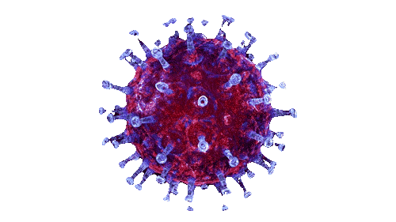
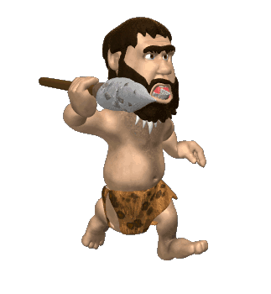
Thank you for your time Questions?

